Slide 1
Microsoft Teams An Introduction
By P Fuhry Comm Officer D-9
Jan 2024
Notes:
MS-Teams replaces GoToMeeting as the On Line meeting software used by CPS-ECP Western Ontario Distict. Microsoft Corp. has gifted free licenses to CPS-ECP.
A brief history of MS-Teams and the computer hardware requirements needed to run Teams is detailed. This section is an introduction to MS-Teams. The initial installation of the software, logging into a meeting and features Teams provides during meetings is outlined.

Slide 2
History
MS-Teams has always been seen as a part of an integrated office software package (CPS-ECP is using it as a separate communications solution)
In 2007 MS bought a company Parlano which had a group chat product called MindAlign. MindAlign was sold the same year after MS incorporated its chat software into MS-Office Communicator
In 2010 MS-Lync replaced Communicator and had a good video chat capability however no one ever used it (e-mail ruled!)
In 2011 MS bought Skype (330 million video chat users) for its user base. These users were slowly brought into the MS fold
Notes:
MS-Teams has always been part of an integrated software package (ie MS-Office). It ‘grew up’ in large corporations. Think office towers were several floors of computers are connected by network cables.
In 2007 Microsoft bought and dissolved a company called Parlano. The software inside Parlano’s chat product MindAlign was incorporated into the MS product Communicator. Later the same year MindAlign was sold off.
In 2011 MS bought Skype for its user base

Slide 3
History
In 2013 the software Slack became very popular as a Teams-like product; business users discovered e-mail wasn’t the best for group communication, collaborative work, and online meetings
In 2016 those in MS who wanted Slack users wanted to buy Slack for $8 billion, Bill Gates nixed the idea and set up a group to create Teams
MS-Teams integration with MS-Office is a very big plus, plus it’s free
In 2019 MS-Teams active daily users exceeded those of Slack
During COVID, Zoom grew massively and is well known however Teams went from 10’s millions to hundreds of millions of users.
Notes:
For CPS-ECP, MS-Teams works and is free

Slide 4
What Your Computer or Phone Needs to Run MS Teams
Windows Personal Computer (Minimum Requirements)
Dual Core Processor, 1.1 GHz or faster (~5 years old)
4 GB RAM
3 GB available disk space (can be a solid state hard drive)
1024 * 768 screen resolution
Operating System – Windows 11, Windows 10
Plug in Video Camera USB 2.0
Turning camera on? Windows 11 or 10 with 4 core processor recommended
MS-Edge (latest + 2 versions back), Google Chrome (latest + 2 version back)
Android Phones
Last four major versions of Android
~oldest Version 11: Red Velvet Cake Sept 8/20, Version 12: Snow Cone Oct 4/21
Notes:
As of Jan 2024, the specifications would suggest your Windows/PC computer should be less than 5 years old and running Windows 10 at least.

Slide 5
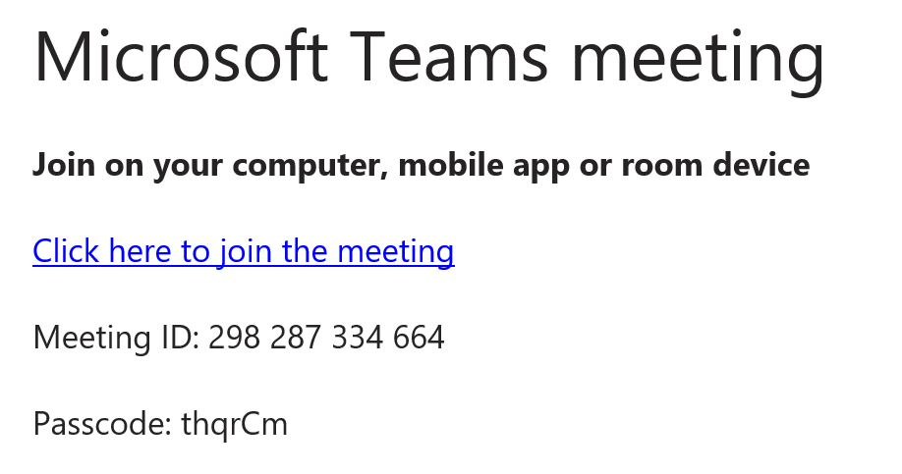
Joining a Teams Meeting
Your Invitation…
- Typically sent to you in the Notice of Meeting
Notes:
To join and MS-Teams meeting, you will normally get an invitation. Click on the link “Click here to join the meeting”

Slide 6
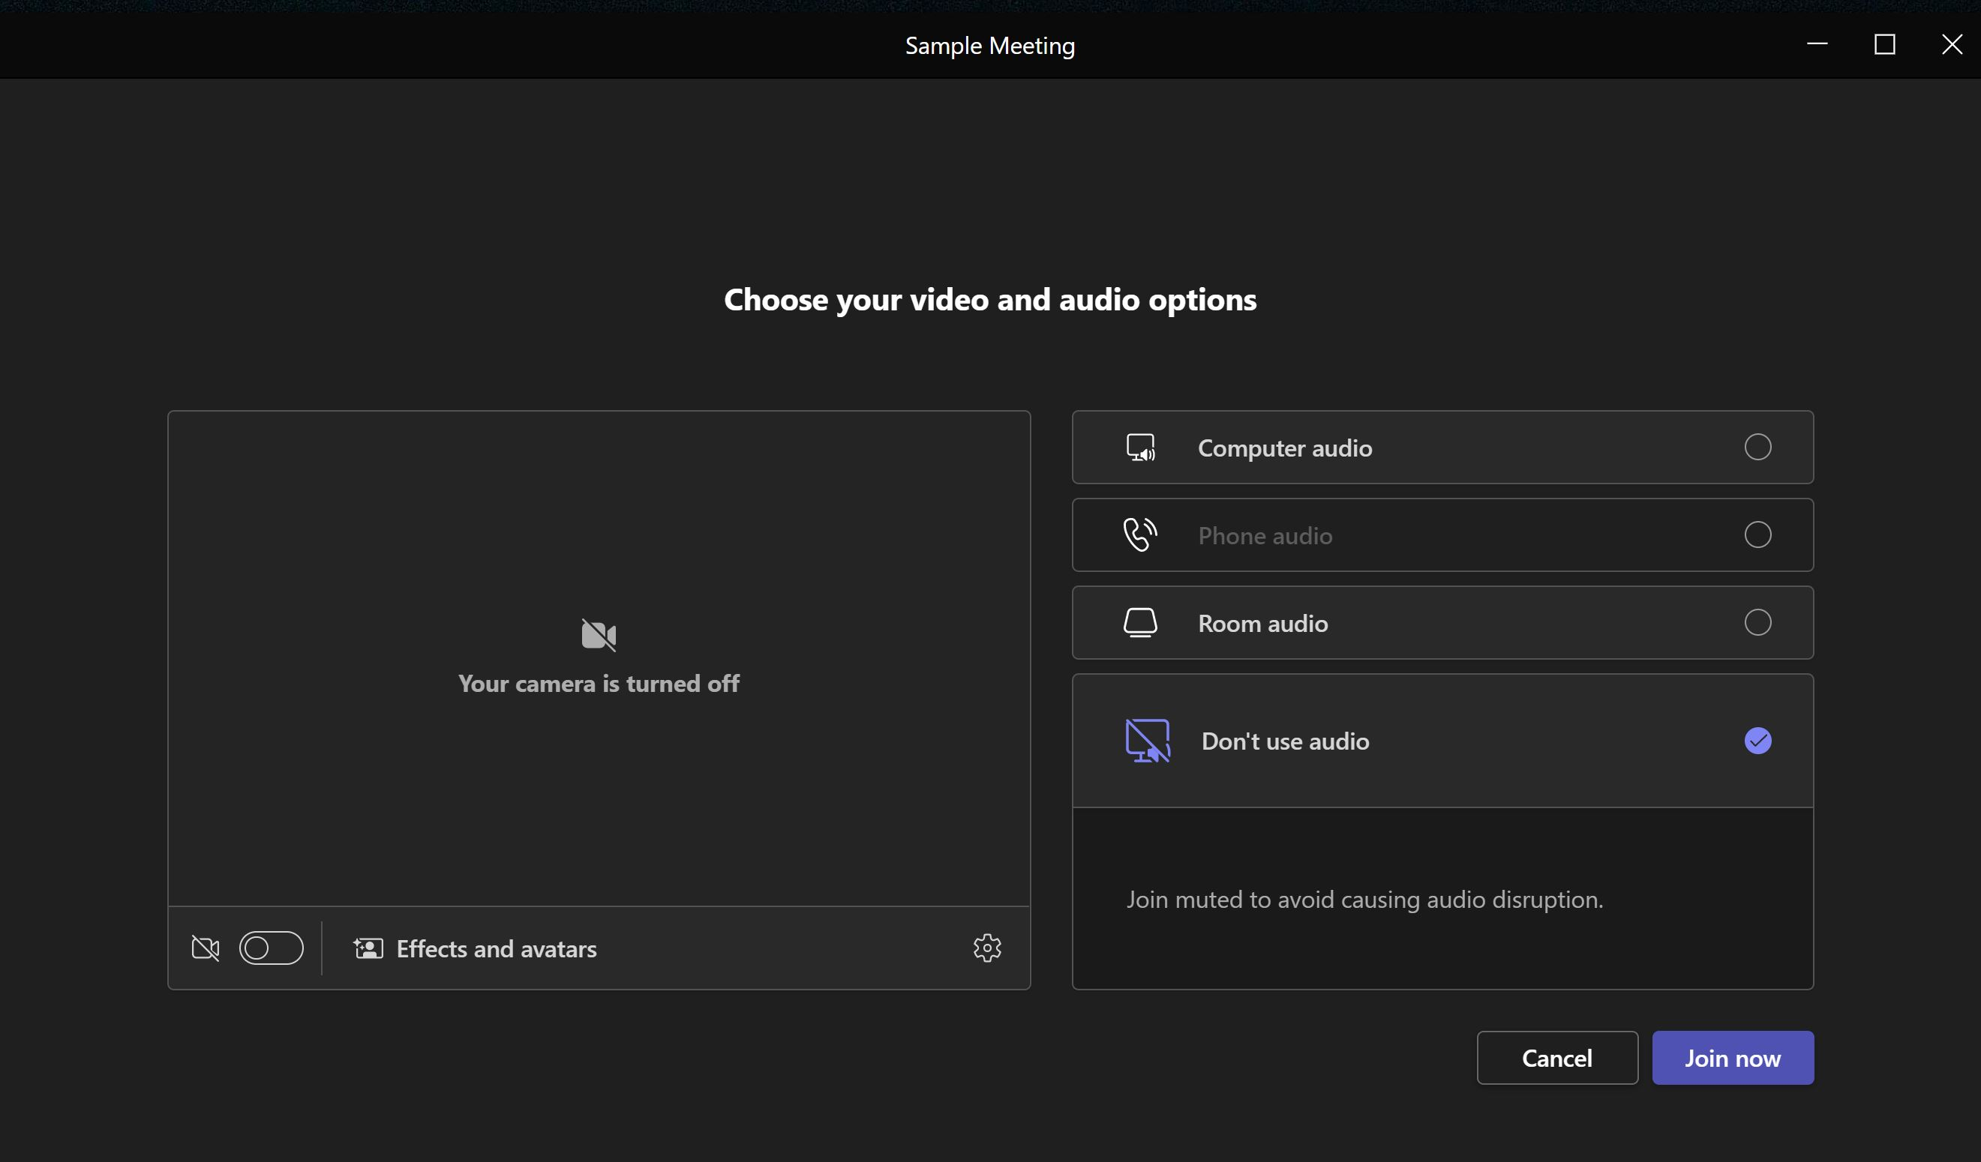
X
Notes:
Your computer will ask if the software can use your microphone and speaker (say Yes) and you will see this screen.
IF “Don’t use audio” is checked, click on “Computer audio” instead
Click “Join Now” button (lower Right corner)

Slide 7
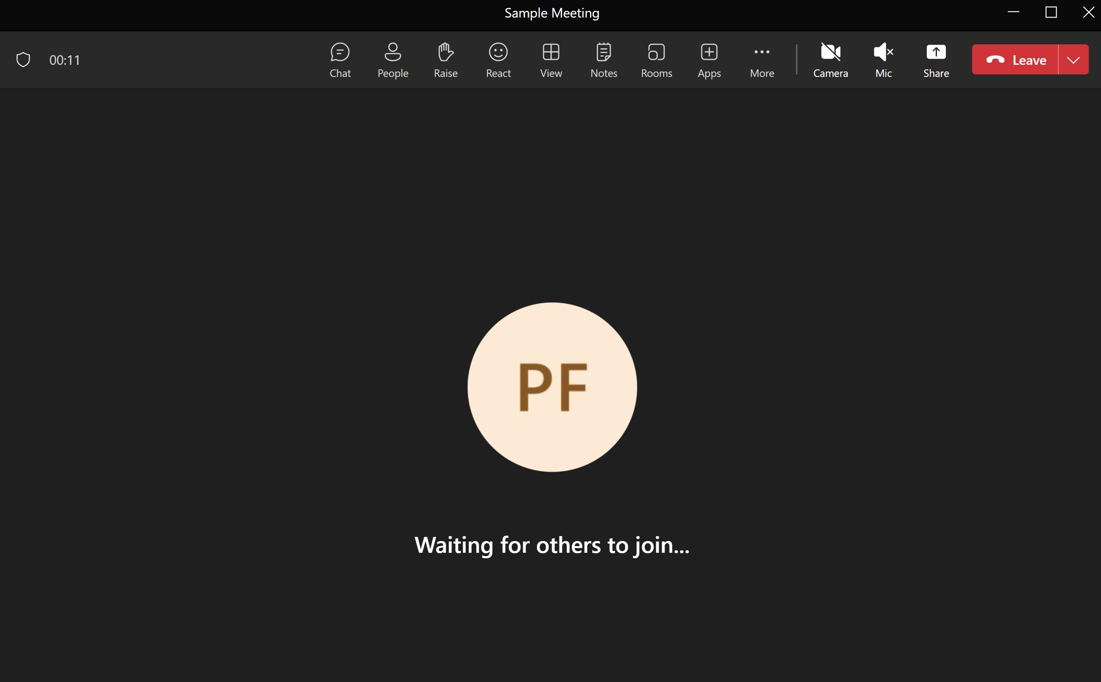
Notes:
If you have left “Don’t use audio” checked, you will see what appears to be a speaker with an X in front of it. Click on it to fix this problem.
Note the red “Leave” button in the upper right hand corner to leave a meeting

Slide 8
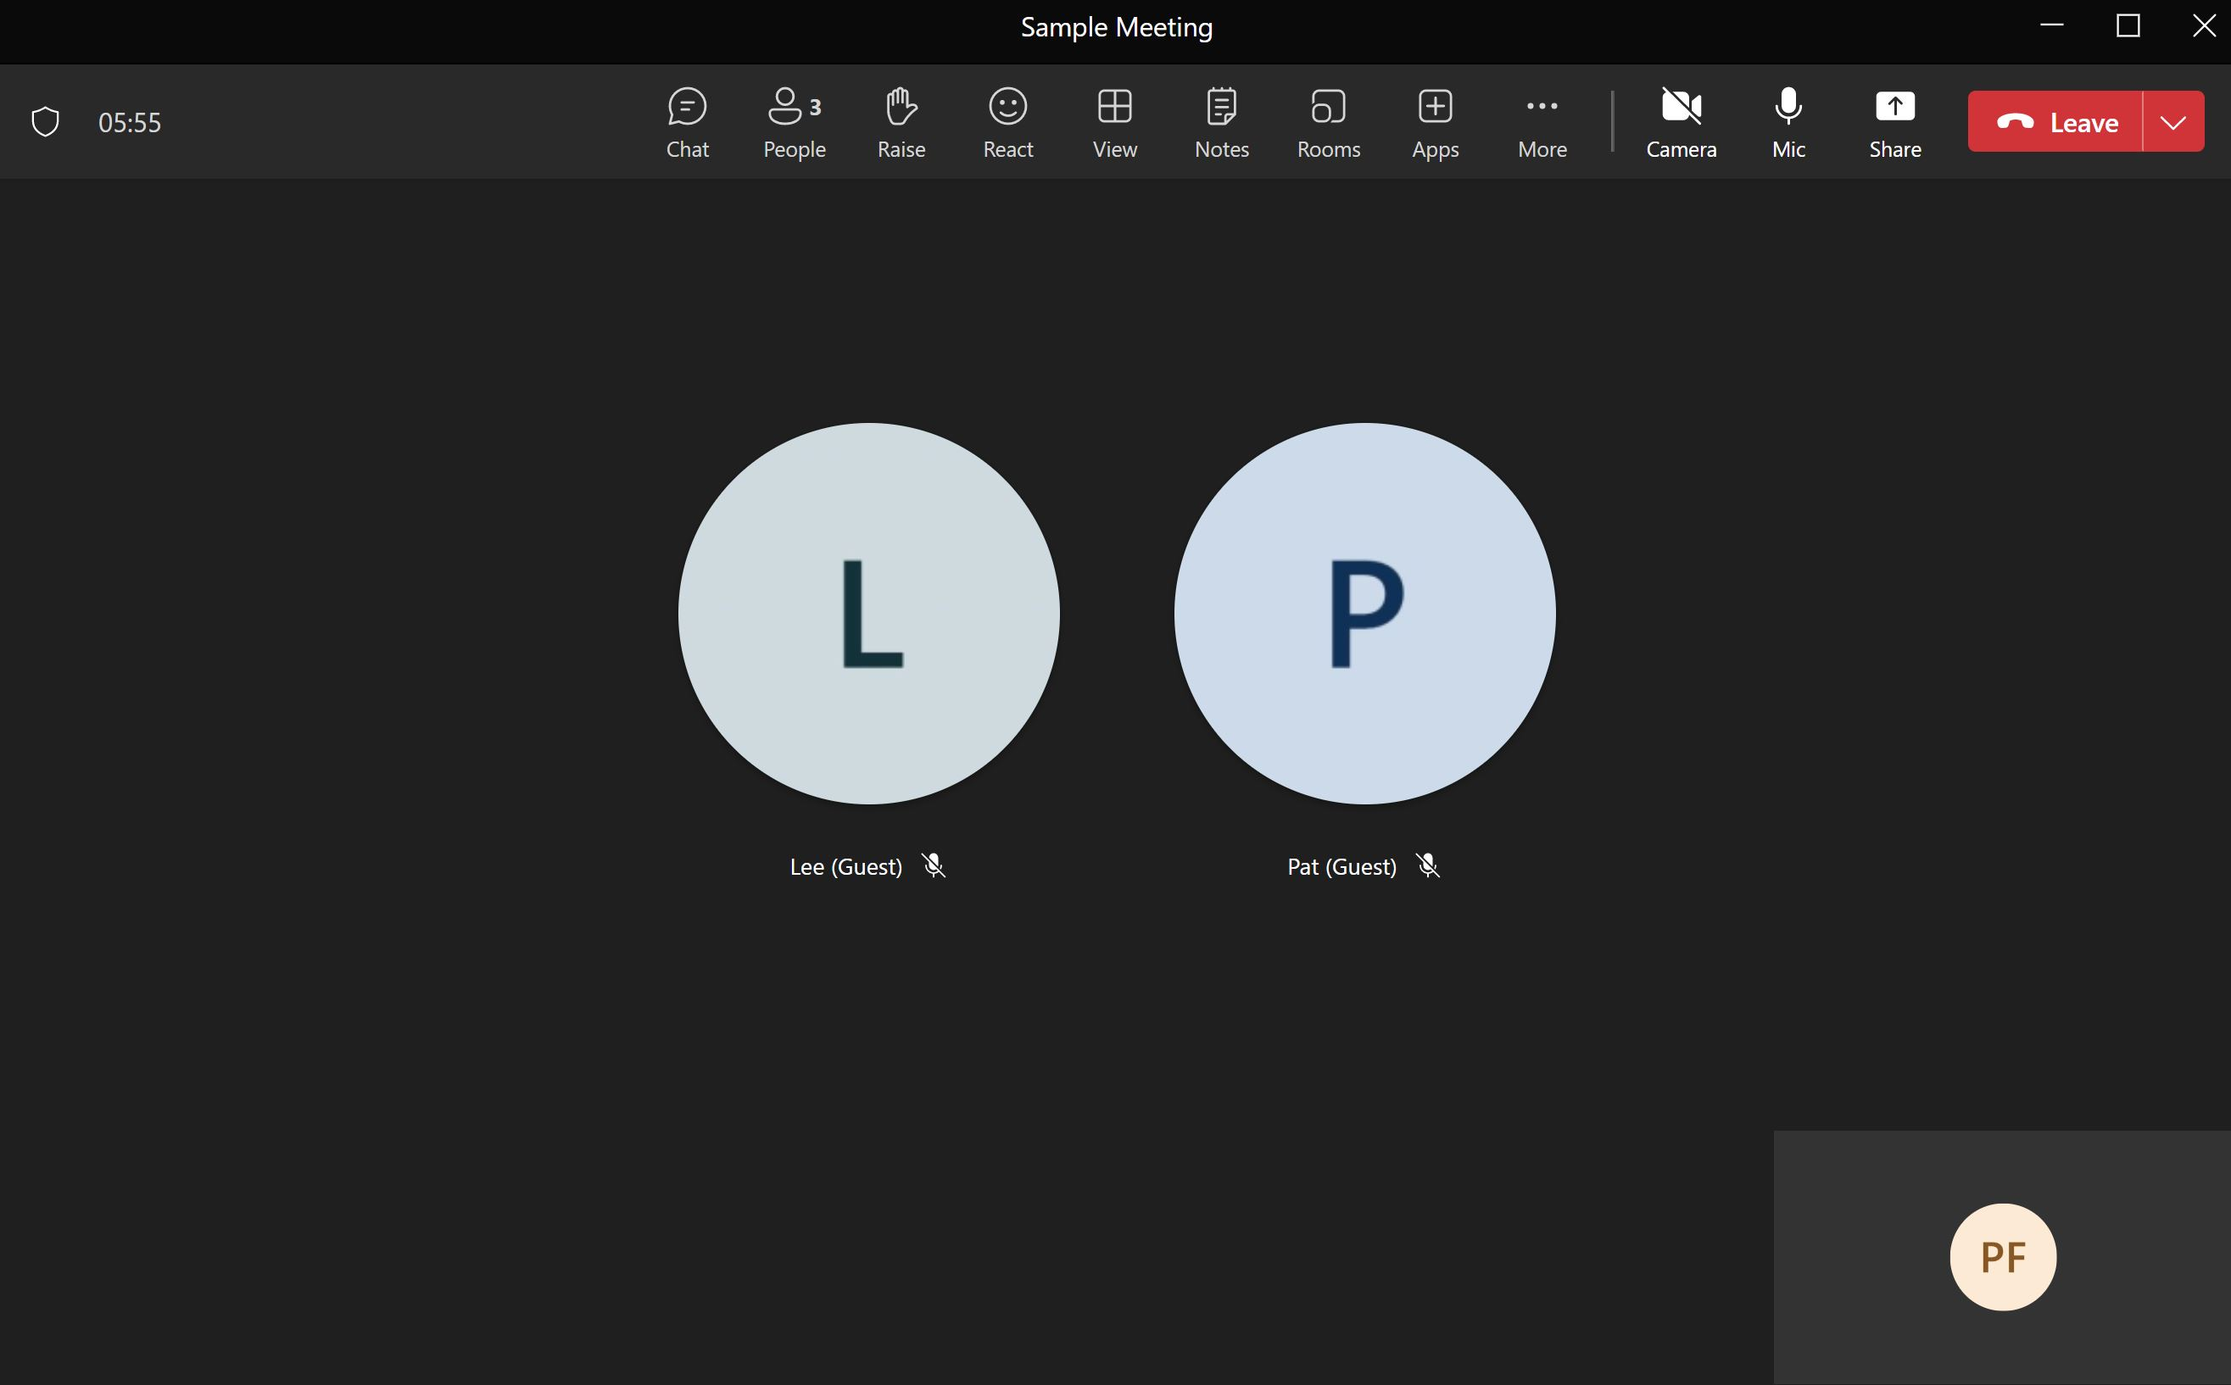
Notes:
This is the screen you will see during a meeting. We do not turn on video so persons who are joining with low speed internet connections won’t have problems.
You are the circle in the lower right hand corner.
NOTE: Persons who want to telephone call into the meeting can not using the licenses Microsoft has provided (its not turned on). A meeting participants may set up a phone next to his/her computer that a caller could contact to hear/talk in the meeting.

Slide 9
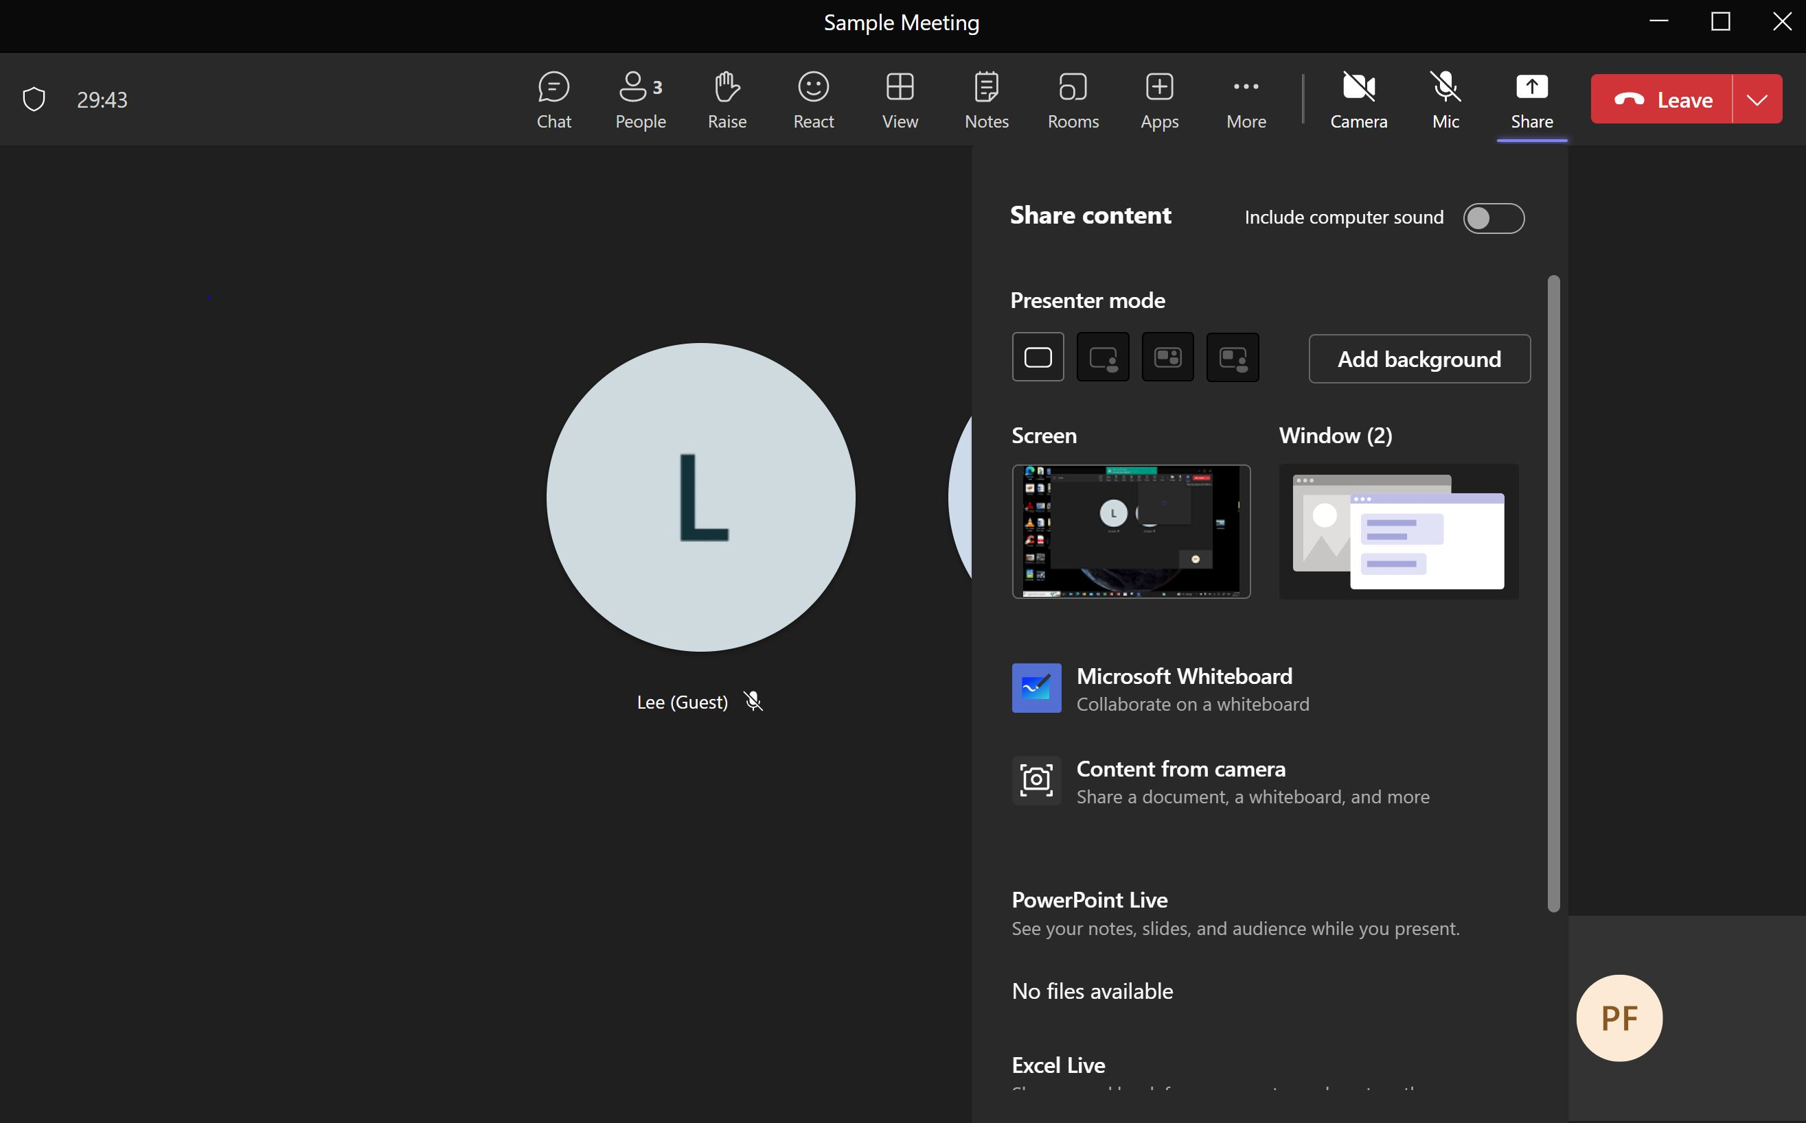
Notes:
In the upper right hand corner is the “Share” button. A person can share the screen or a window. Click on “Screen”

Slide 10
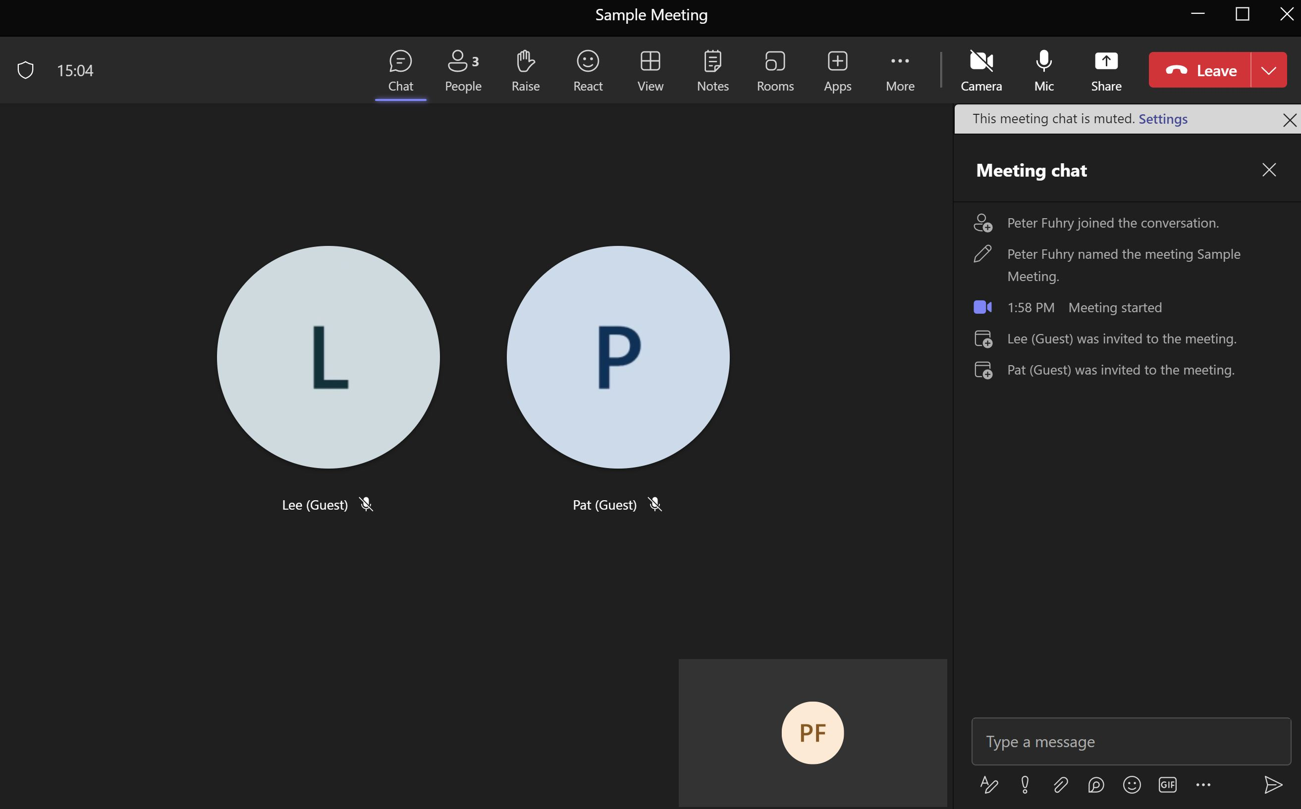
Notes:
Across the top of the screen are a series of buttons. Starting at the left is “Chat”
Clicking on “Chat” a column opens up on the right side of the screen. At the bottom on that column is a place to type your message. Below it is a series of buttons including the Send button on the far right (it looks like a paper airplane pointing to the right). Another of the buttons is and A with a pen. This lets you format (ie bold text) your message. You can also attach a file (using the paperclip) to share a file.

Slide 11
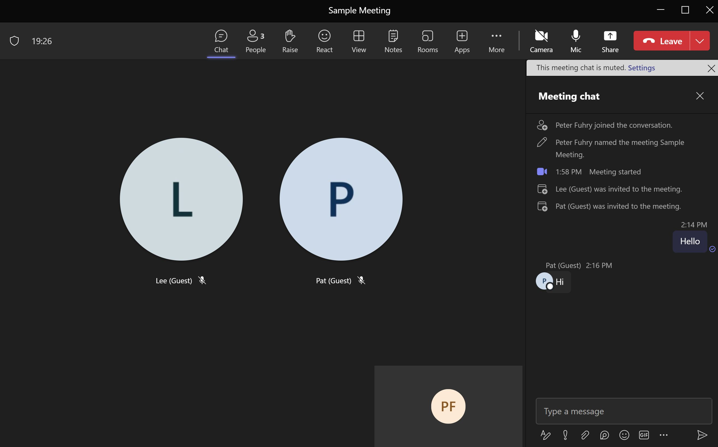

Slide 12
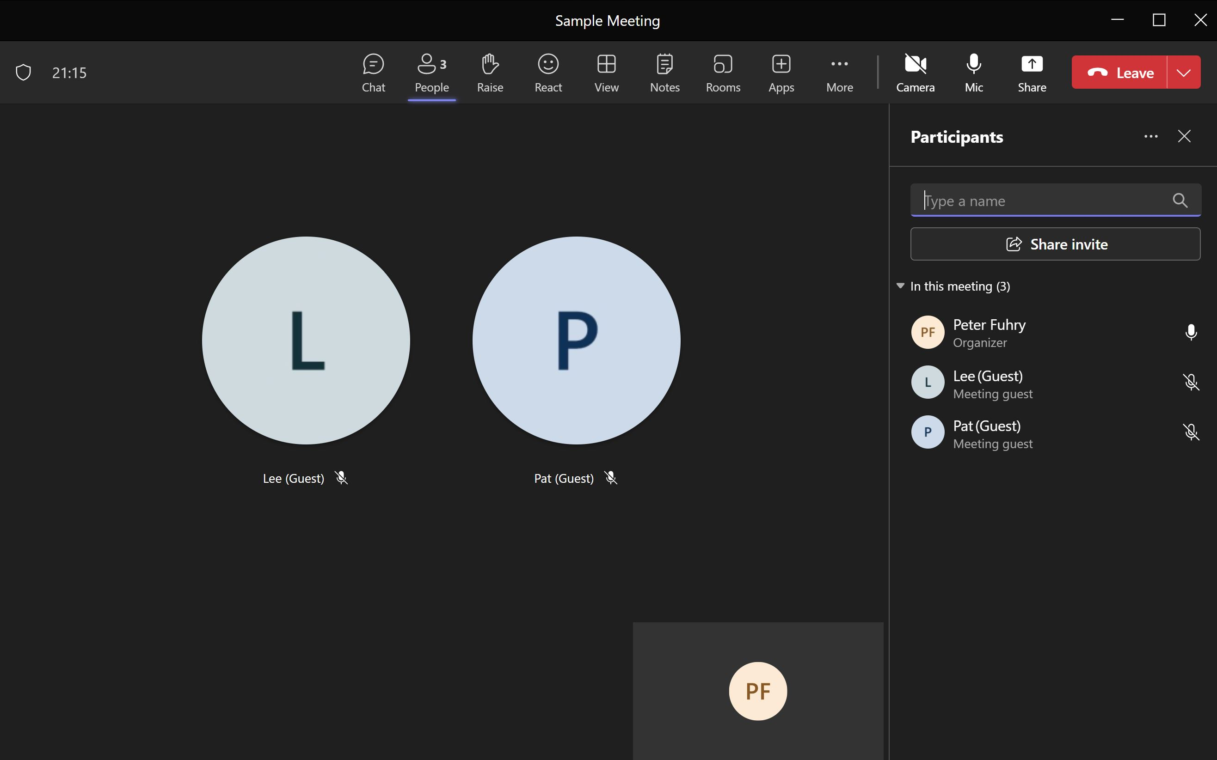
Notes:
Next to the “Chat” button is the “People” button. For long lists of participants you type part of there name. There are ellipses (ie … ) to the right of the Participants title, clicking of the ellipses you get…

Slide 13
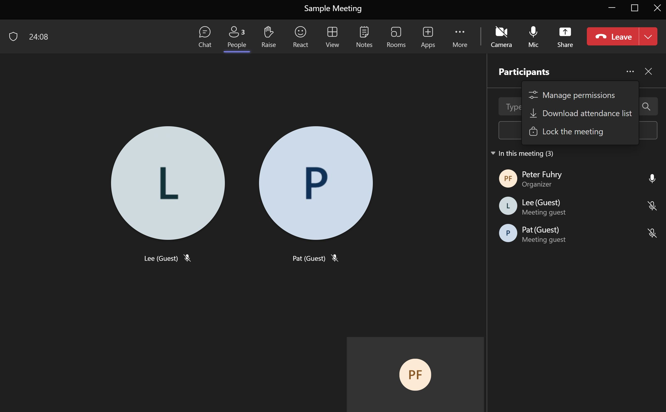
Notes:
A small menu with an ability to download the participants list.

Slide 14
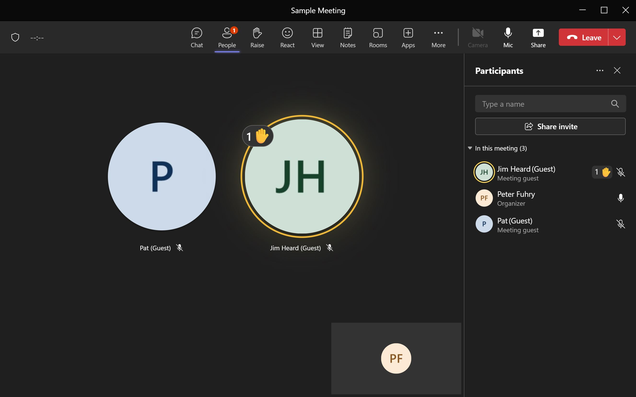
Notes:
The button next to “People” is the “Raise” button to raise ones hand.

Slide 15
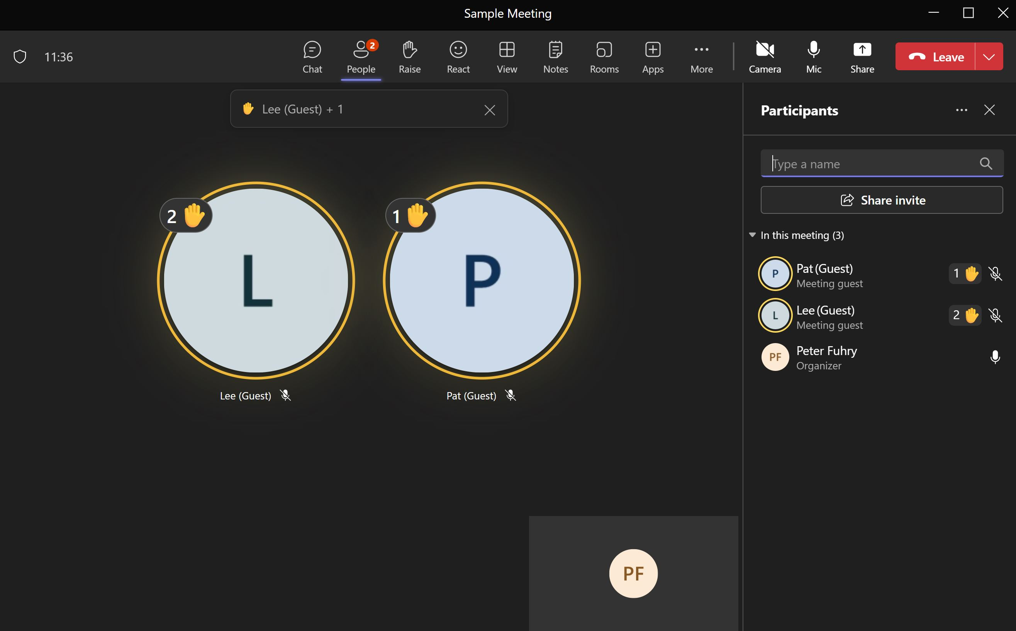
Notes:
If more than one person raises their hand Teams keeps track of the order. This can be useful during discussions or during voting.

Slide 16
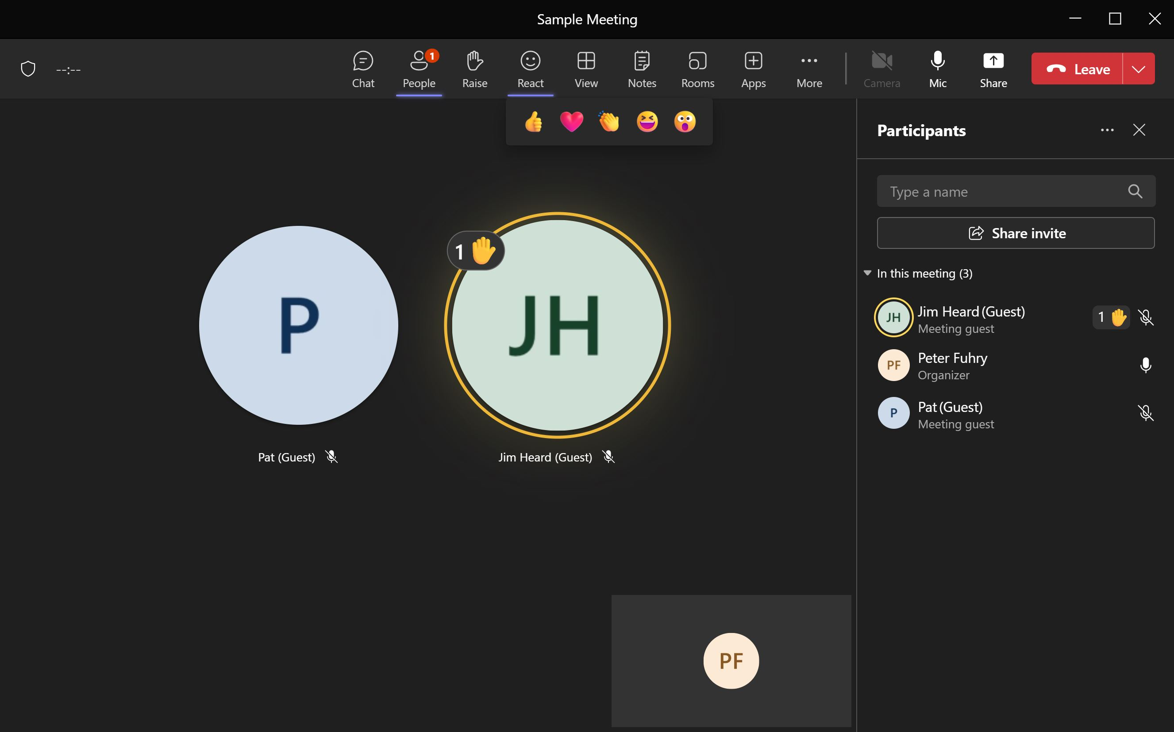
Notes:
Next button over is the “React” button. You can select a reaction (ie thumb up, surprise…) that will appear for a few seconds

Slide 17
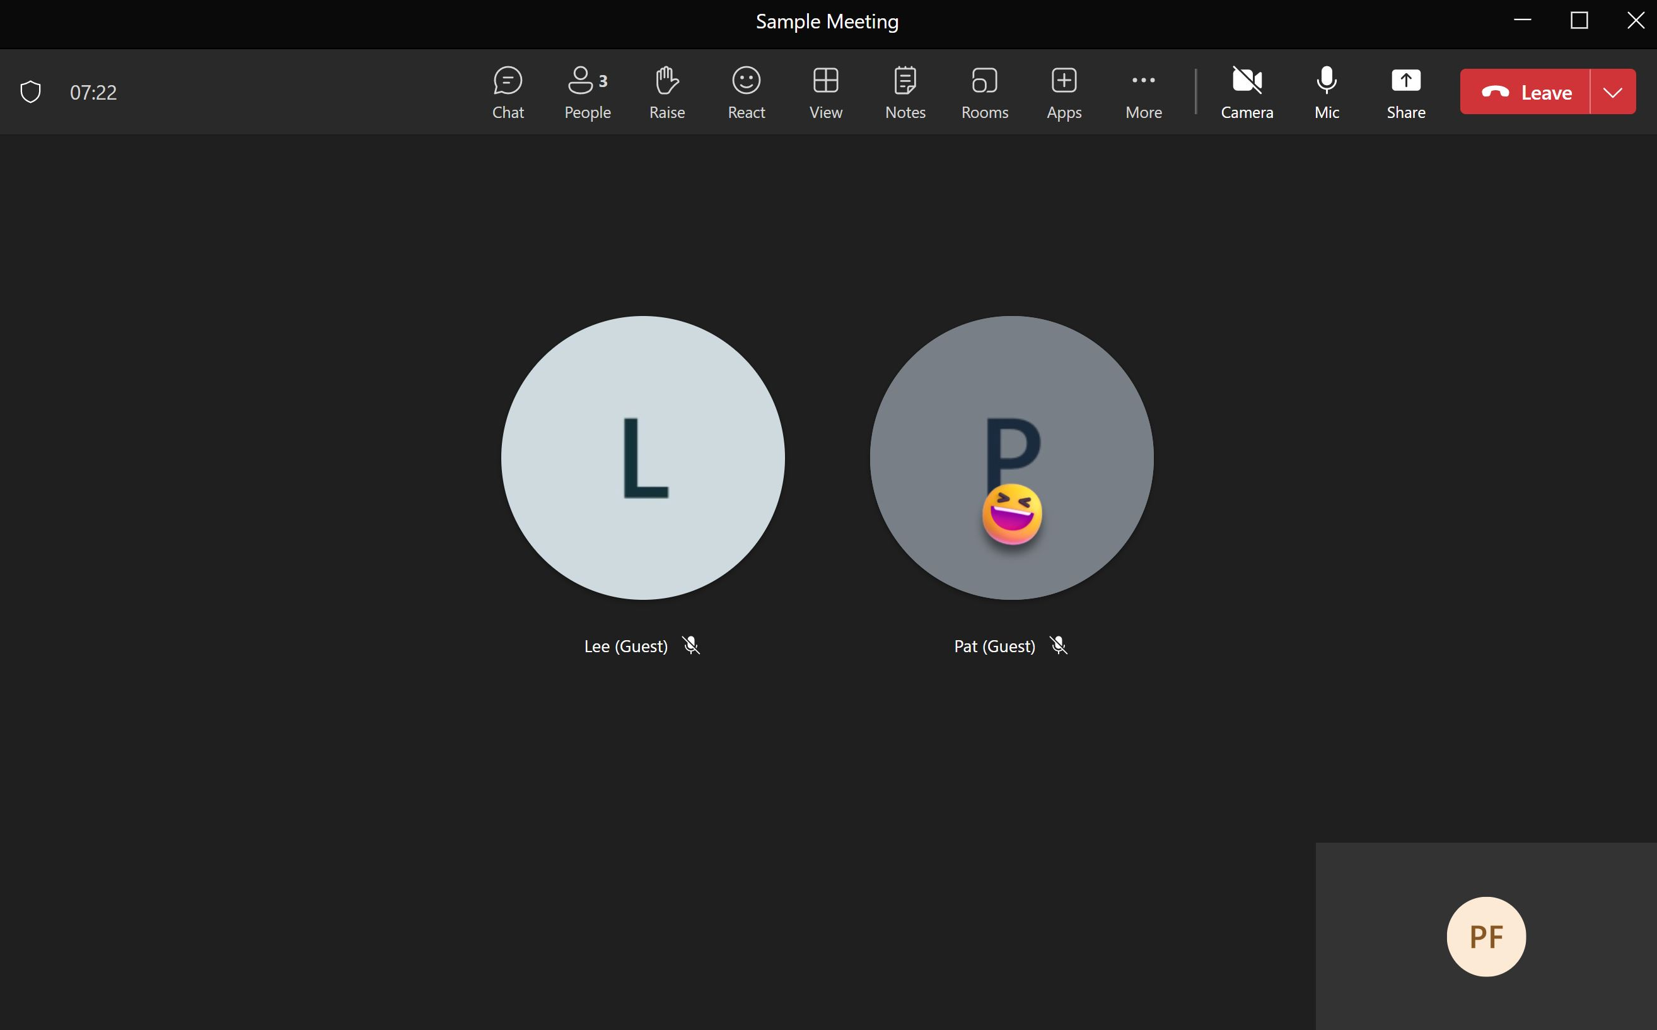

Slide 18
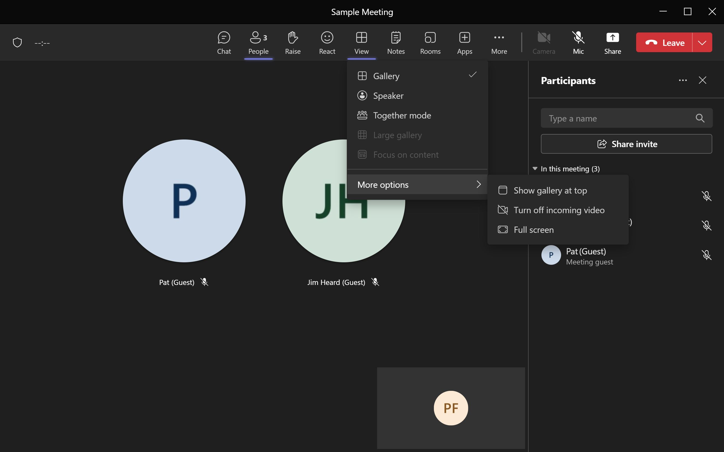
Notes:
“View” is the next button, under More Options is the ability to turn off incoming video. If you select “Full Screen” you can use the “ESC” computer key to return to ‘normal’ mode.

Slide 19
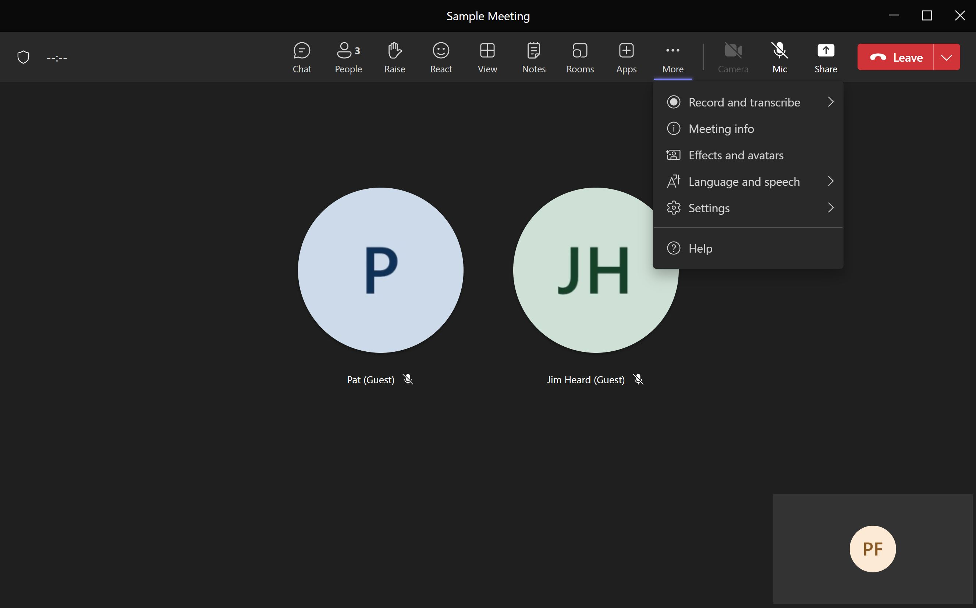
Notes:
Clicking on the ellipses will drop down a menu.

Slide 20
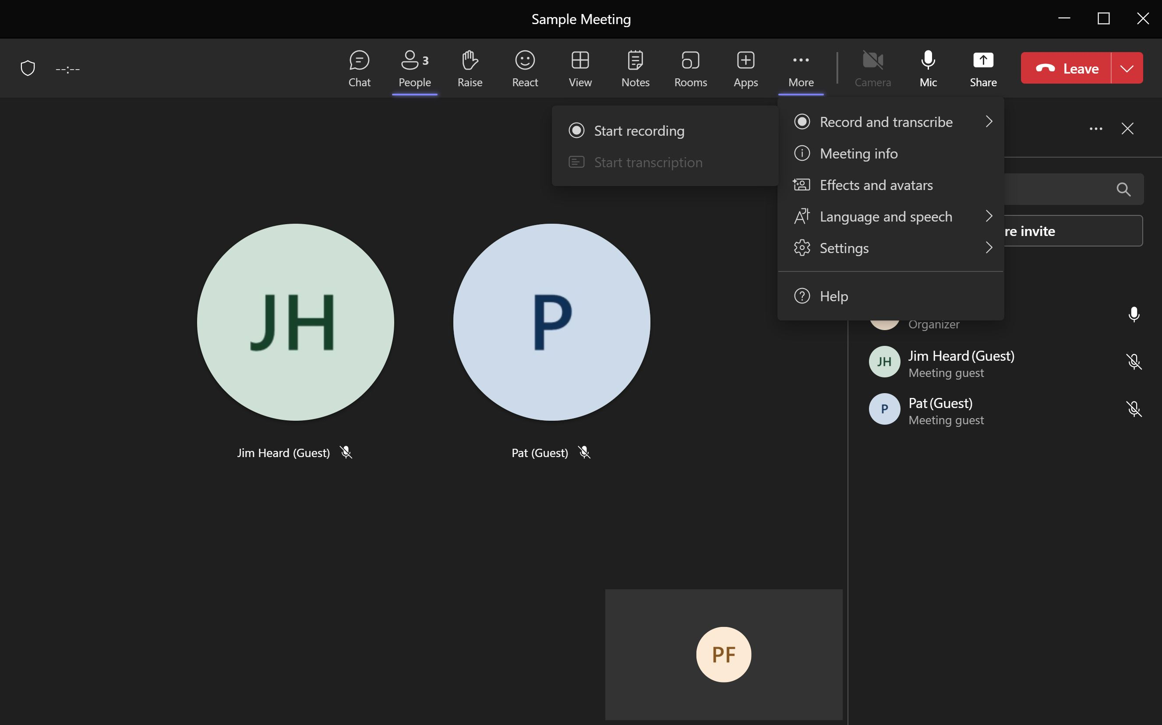
Notes:
Clicking on “Records and Transcribe” will give you the ability to record a meeting. If you record a meeting you and the organizer will get a copy of the recording. PLEASE let the secretary start the recording!

Slide 21
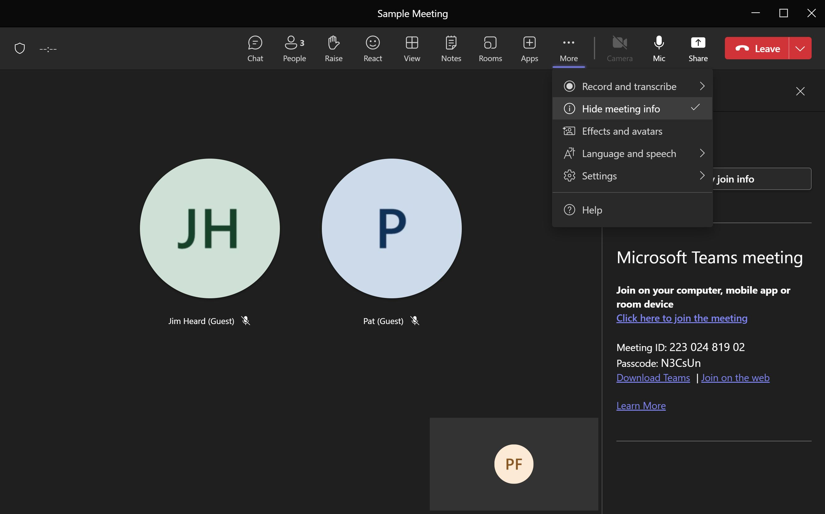
Notes:
“Show Meeting Info” will provide you with the meeting details you can cut/paste and e-mail it to someone.

Slide 22
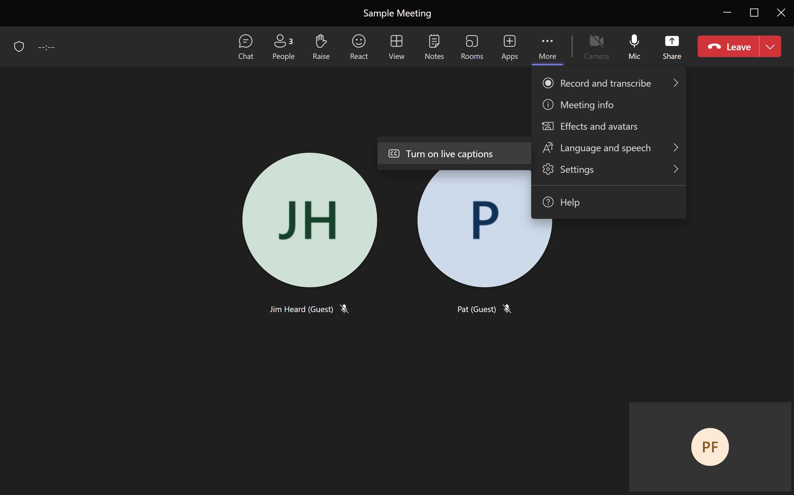
Notes:
One can turn on captions (untested as of Jan 2024 by the presenter)

Slide 23
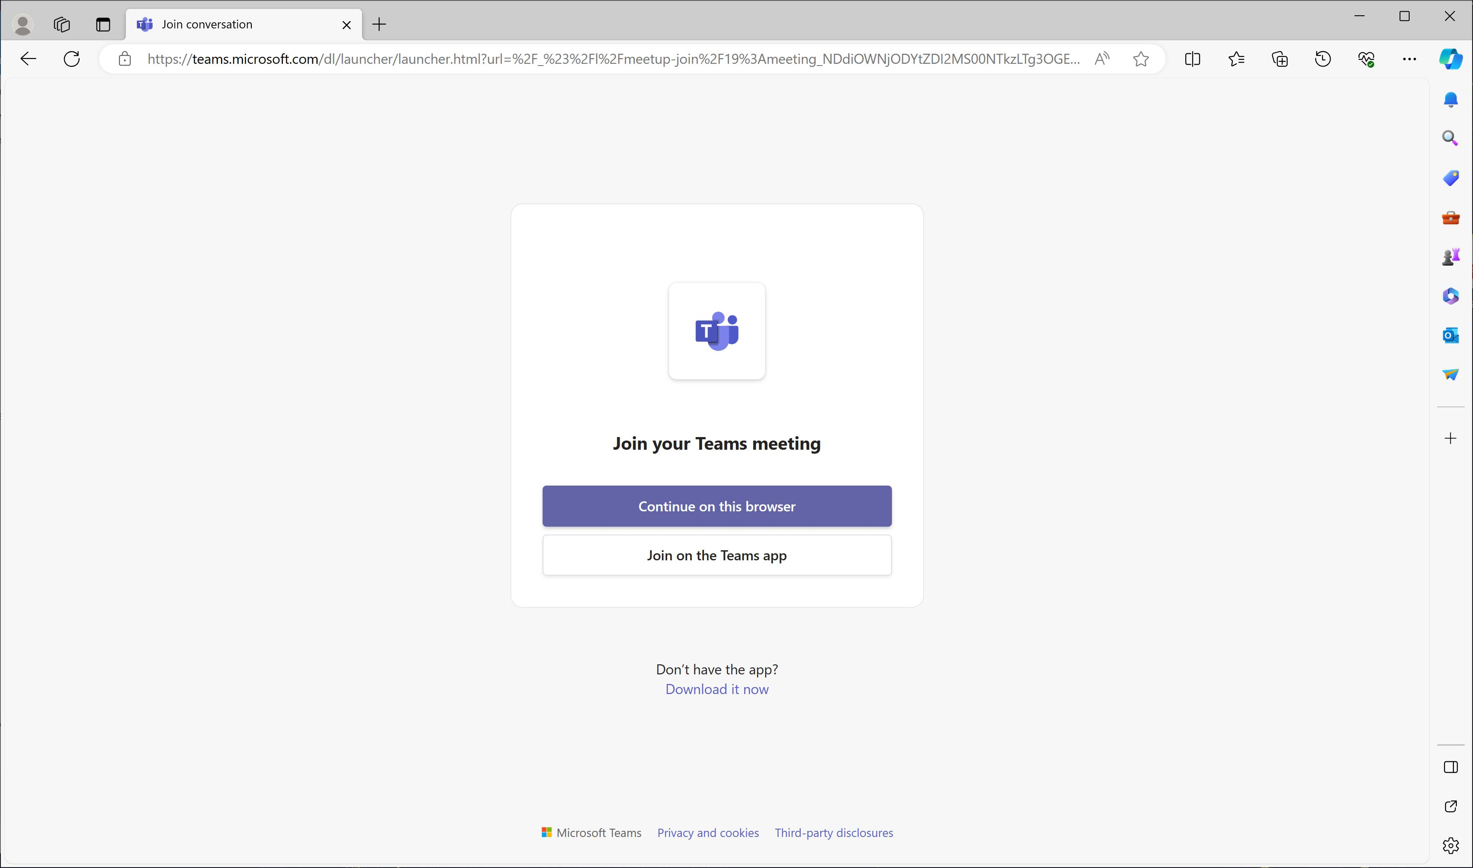
Notes:
You can also run Teams from the browser directly without installing the software. If you do, you will see this screen

Slide 24
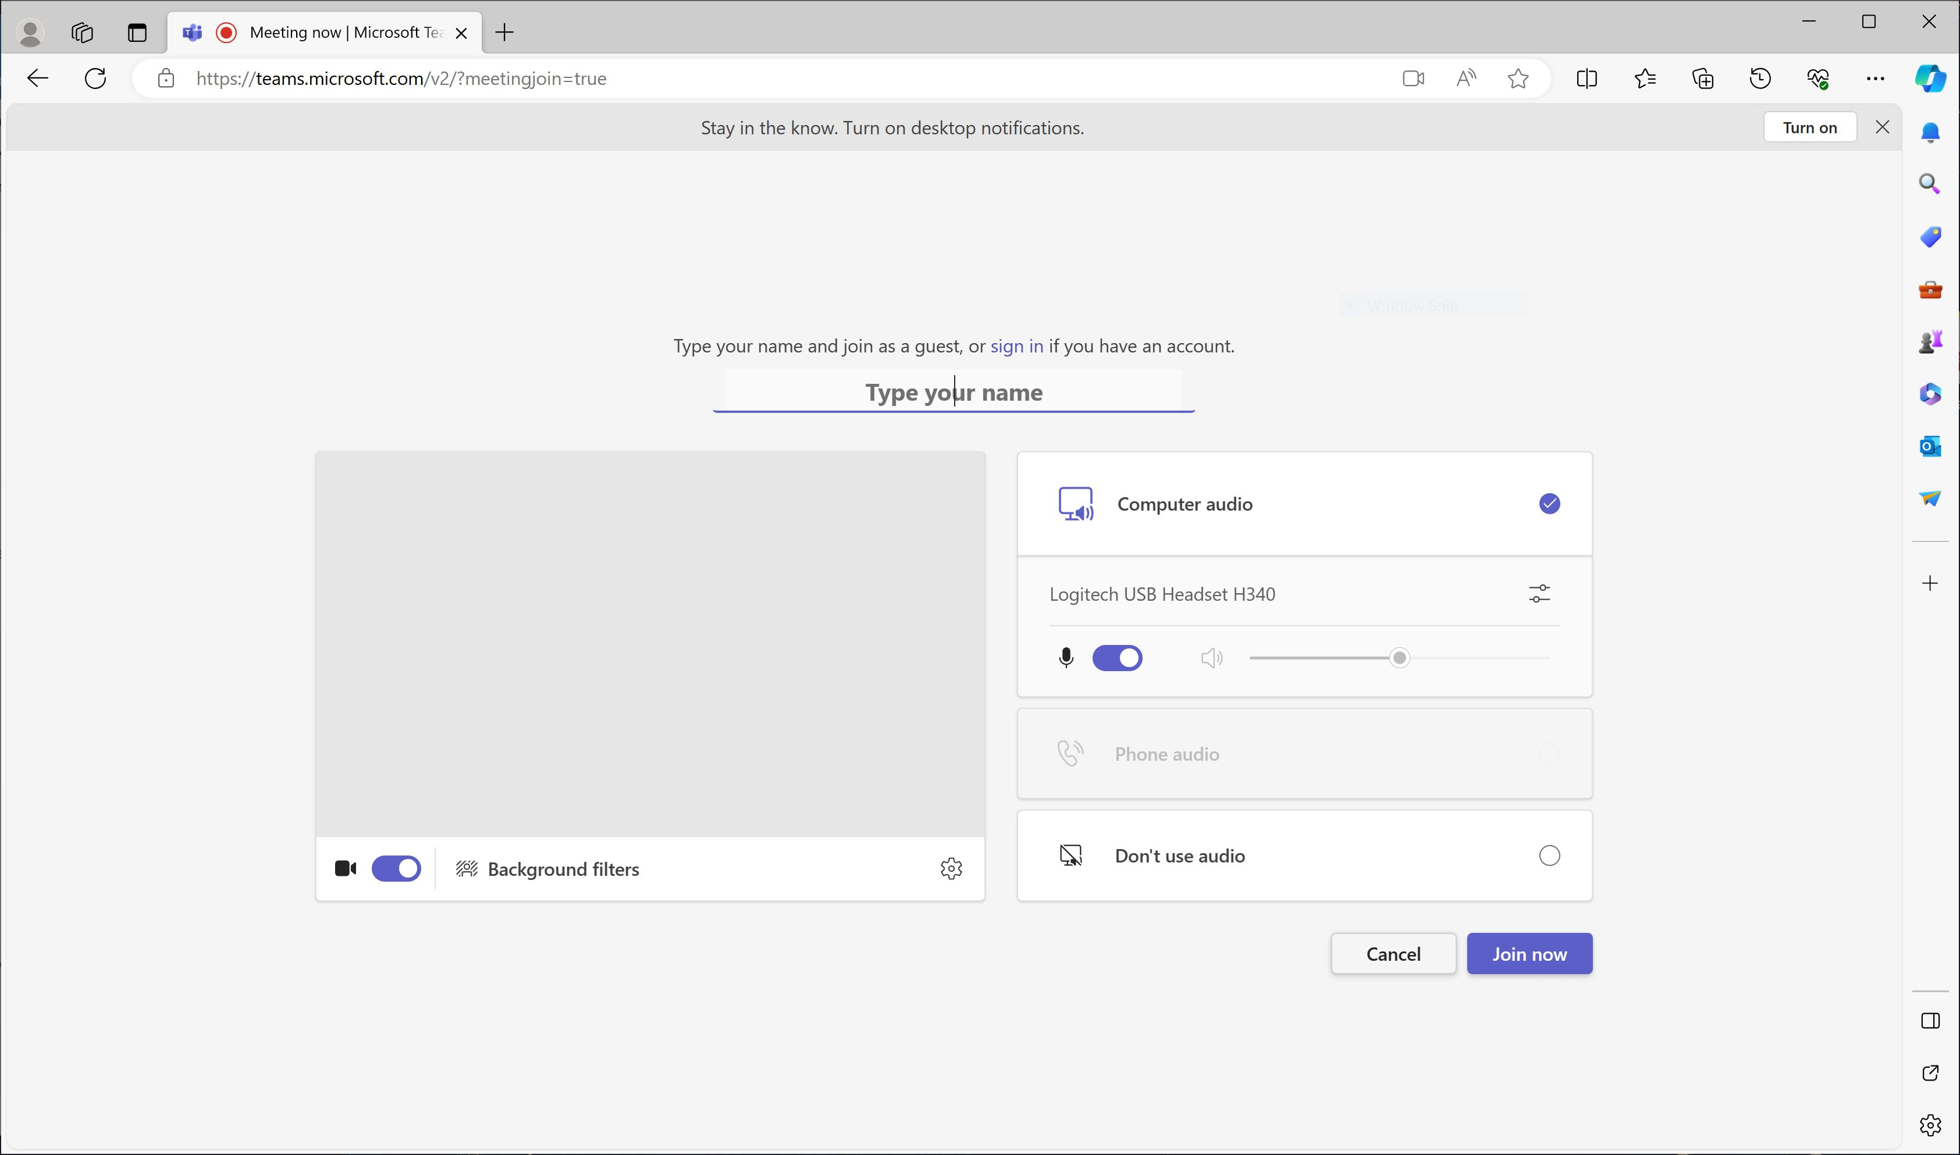
Notes:
Followed by this screen – again, do not have “Don’t us audio” clicked

Slide 25
The End
(of this section)

