Slide 1
Microsoft Teams File Sharing +
Notes:
MS-Teams permits files to be shared

Slide 2
File Sharing using Teams
Must have a MS-Teams license to share files
Permits collaborative work with a closed group of CPS-ECP members
Can be used to store files for closed group while license(s) are held
Files at Hand during meetings
Files may be created, edited, deleted by closed group members
Not useful for file access to general membership & public
District/Squadron Website can be used for general access
Notes:
Shared files can be worked on but more than one person. For example, a budget, a policy, etc. Note persons may cause destructive edits, deletions because of ignorance.

Slide 3
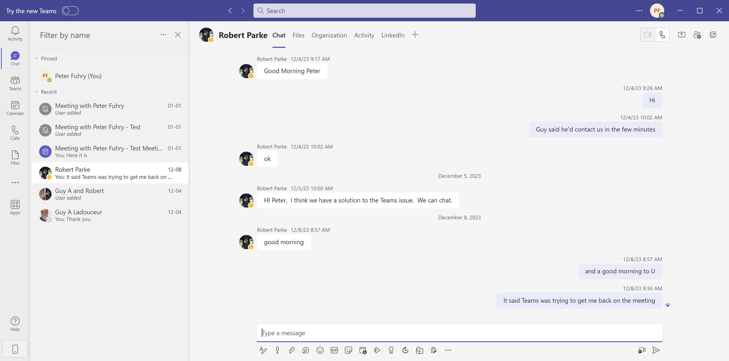
Notes:
This is the Teams software main screen. On the left hand side can be found a verticle line of buttons. Chat is currently shown. One can use windows cut/paste feature or drag and drop to add a file to the chat-conversation in progress. The “Search” box at the top of the screen lets you pick out who you want to chat with. Groups (ie Western Ontario District Executive) can also be selected

Slide 4
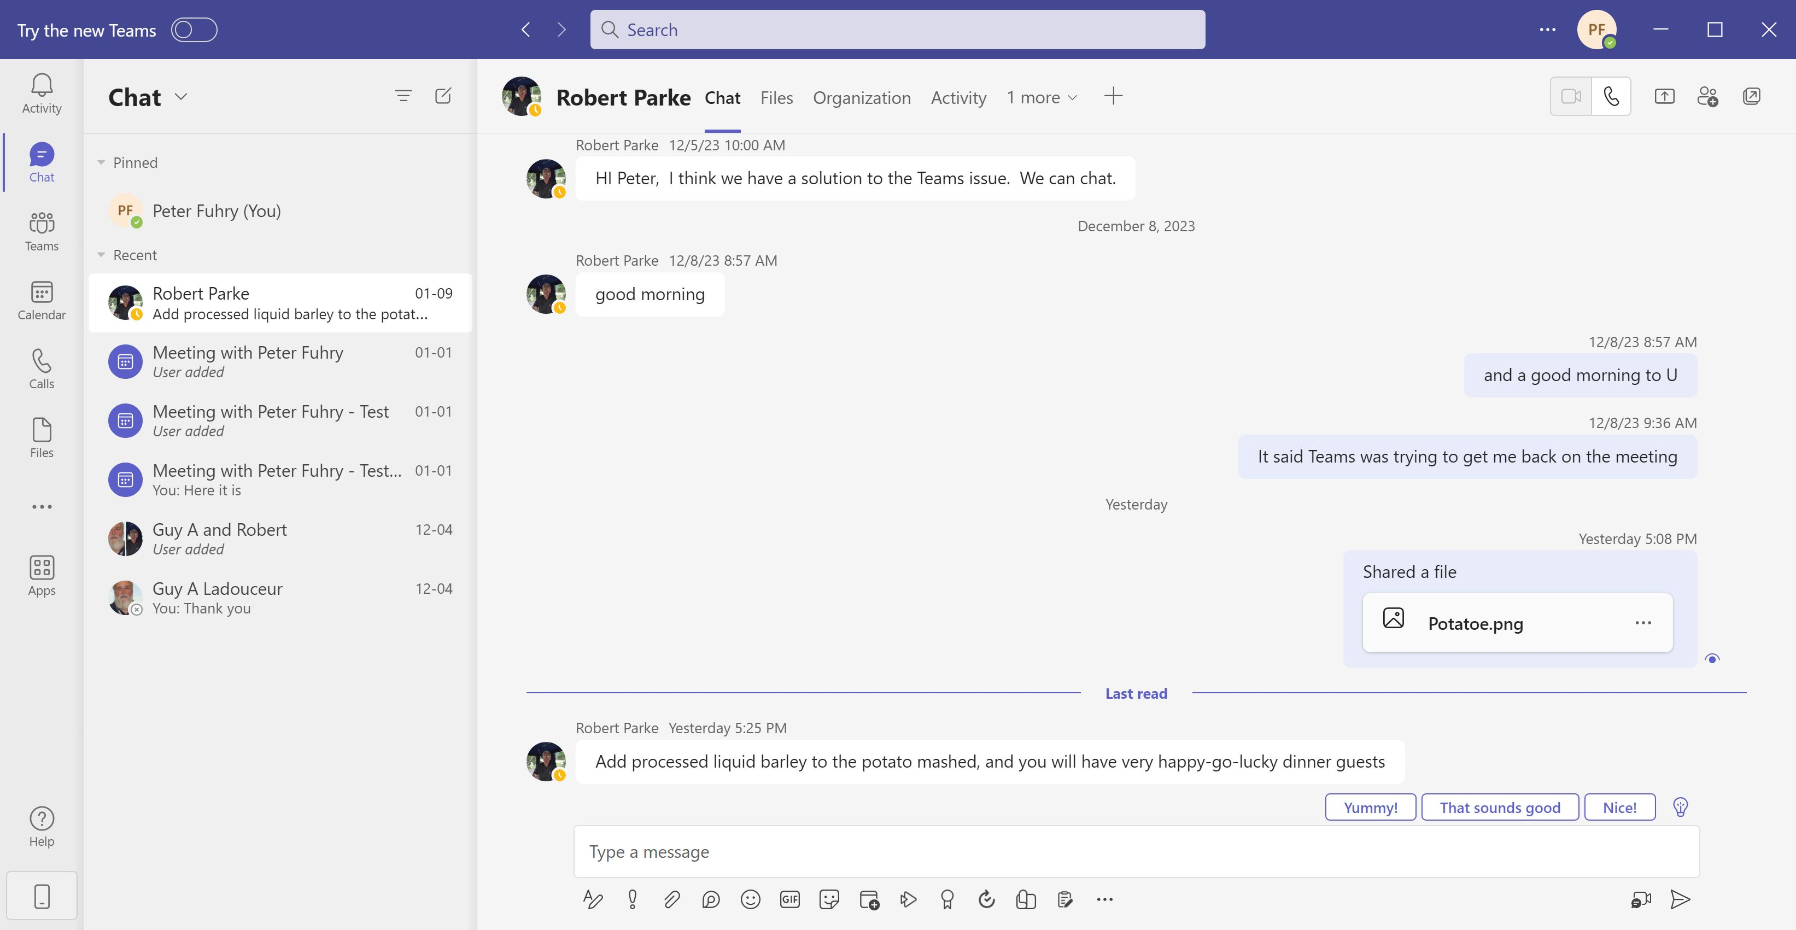
Notes:
In the case the “Potato” file was dragged into the chat and automatically shared

Slide 5
Notes:
What Potato file contained

Slide 6
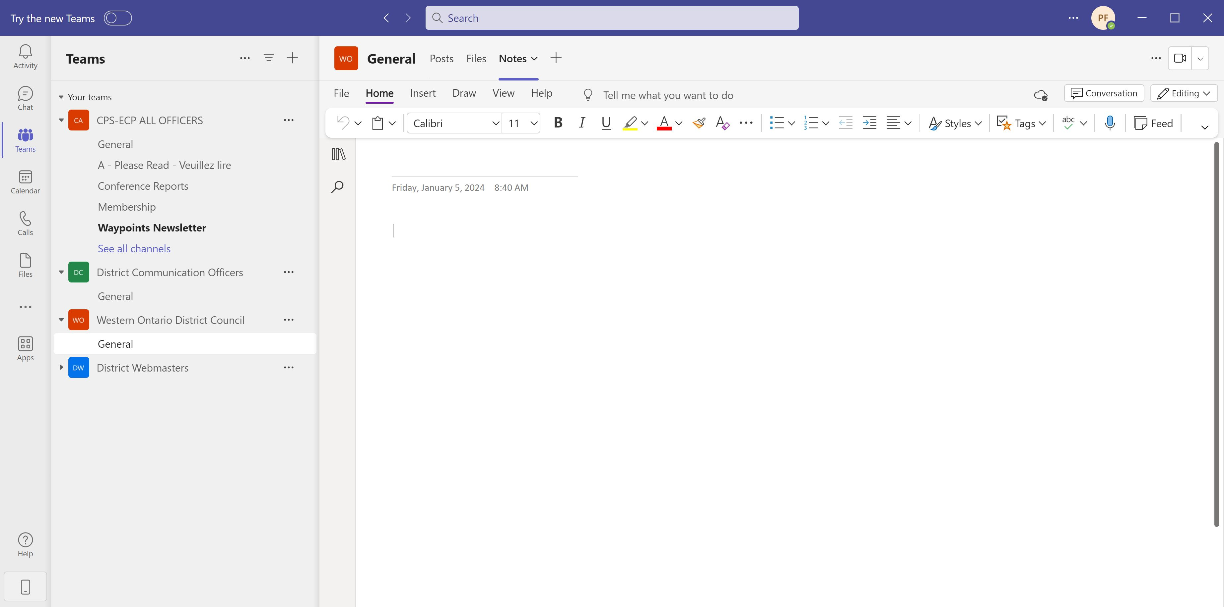
Notes:
The Teams button is selected. Teams can be created (groups of users) and channels (a selection of those users) set up. Typically a channel has a focus or specific purpose (ie National AGM Committee)

Slide 7
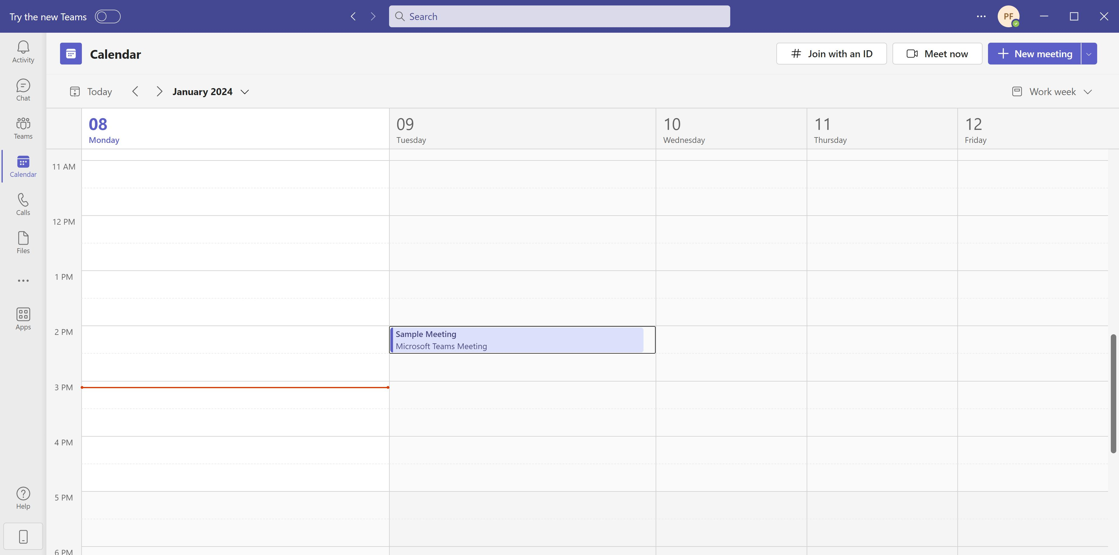
Notes:
If the Calendar button is pressed, one gets the calendar showing Teams meetings set up . In the upper right corner are buttons to start meetings or schedule future meetings

Slide 8
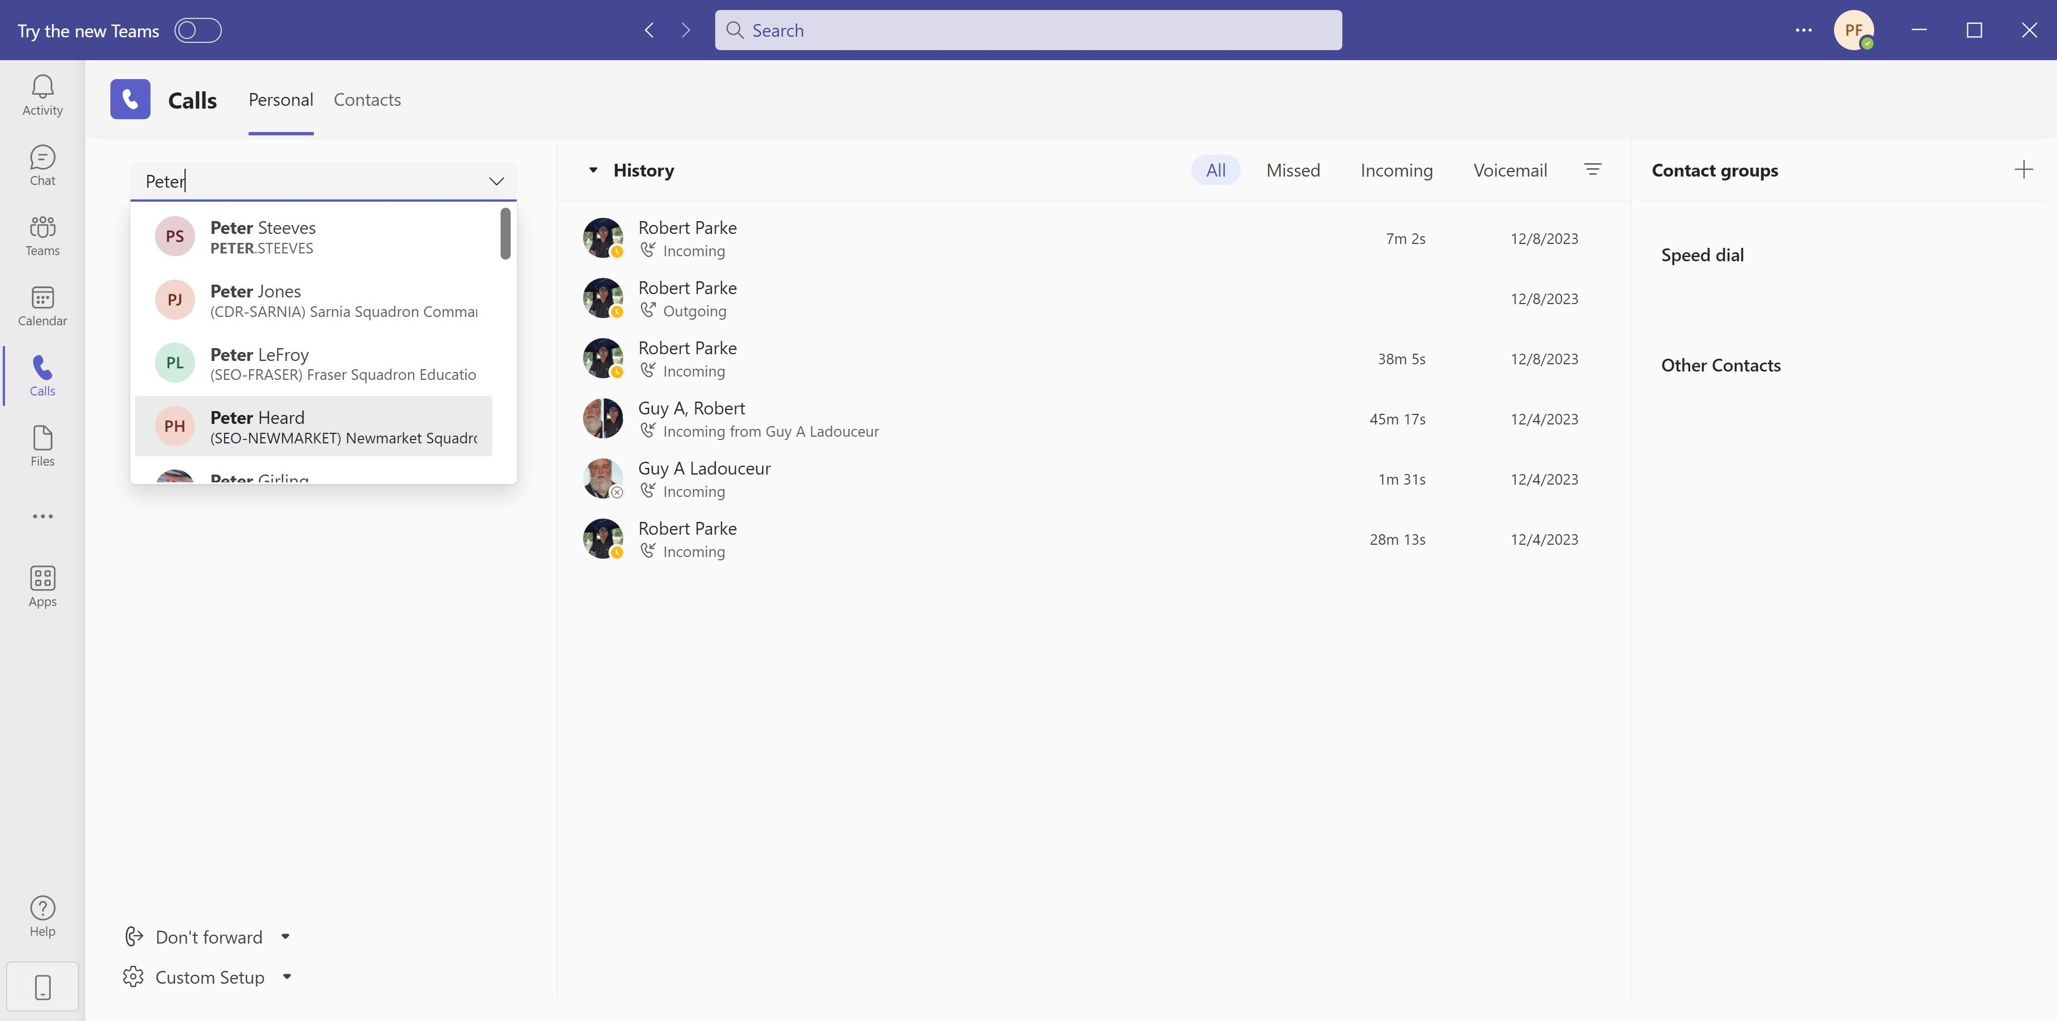
Notes:
The Call button lets one voice call another user (see the search button at the top) on your computer

Slide 9
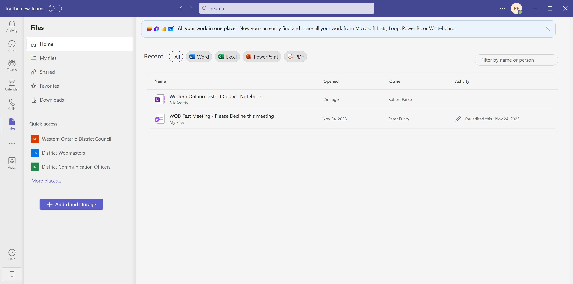
Notes:
Selecting the Files button brings up a comprehensive Files area. The Home button (top left-ish) leads to recent additions.

Slide 10
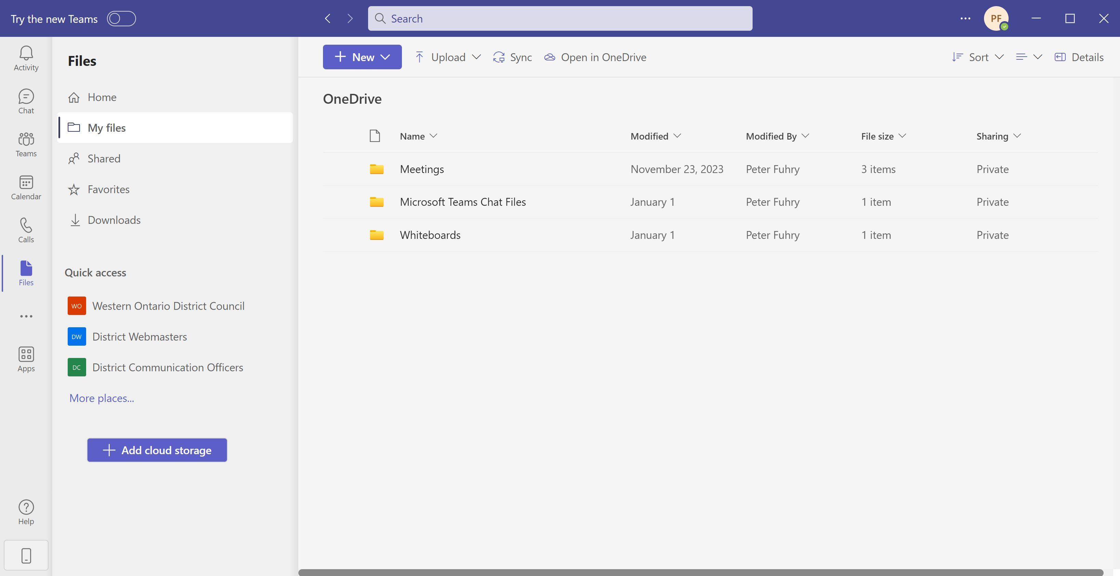
Notes:
The My Files button shows files that you have access too, including files you have added. In this case a number of subfolders are shown

Slide 11
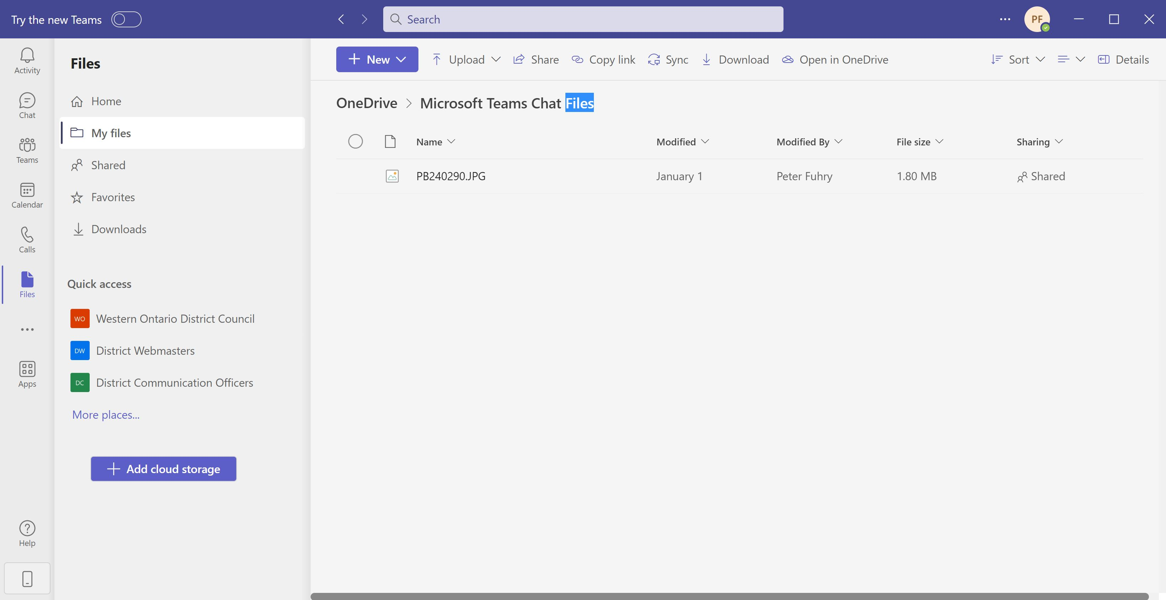
Notes:
Selecting the Microsoft Teams Chat shows the file added in the chat function

Slide 12
Notes:
This is that file opened. It is a screen shot the WOD website in 2019

Slide 13
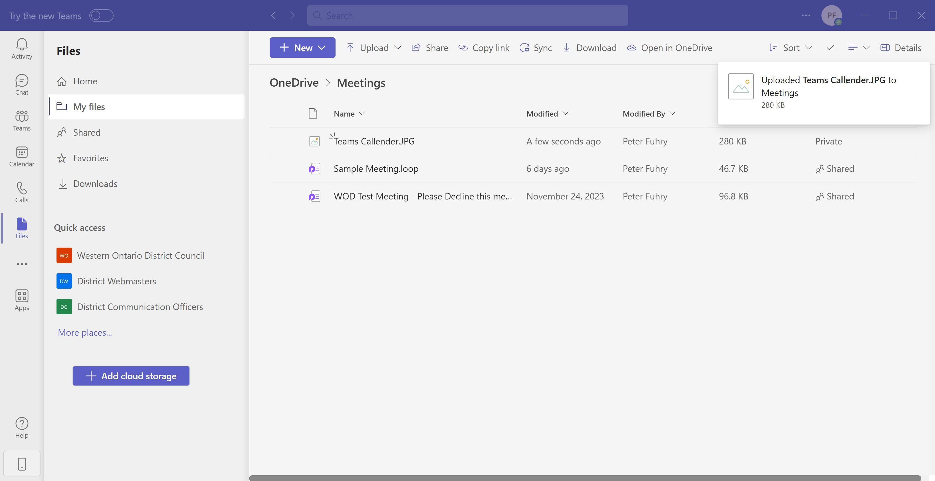
Notes:
On this screen a file has been dragged into the Meetings subfolder a few seconds ago. By default it is private - we want to share it

Slide 14
Notes:
Selecting the file brings up the share icon (box with arrow leaving it to the right)
Clicking it….

Slide 15
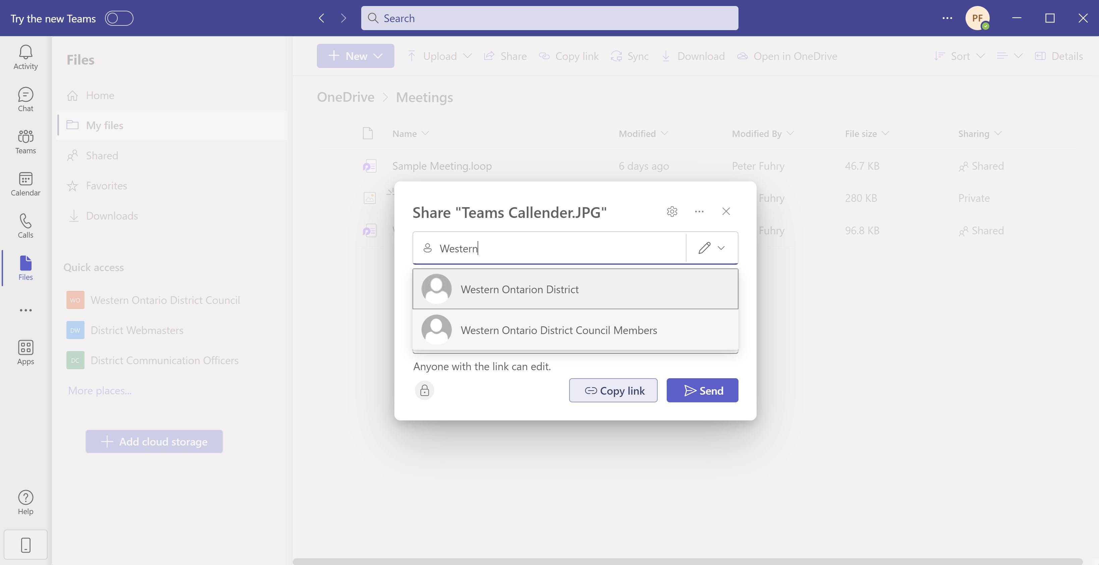
Notes:
…This window pops up where you can identify who you want to share the file with

Slide 16
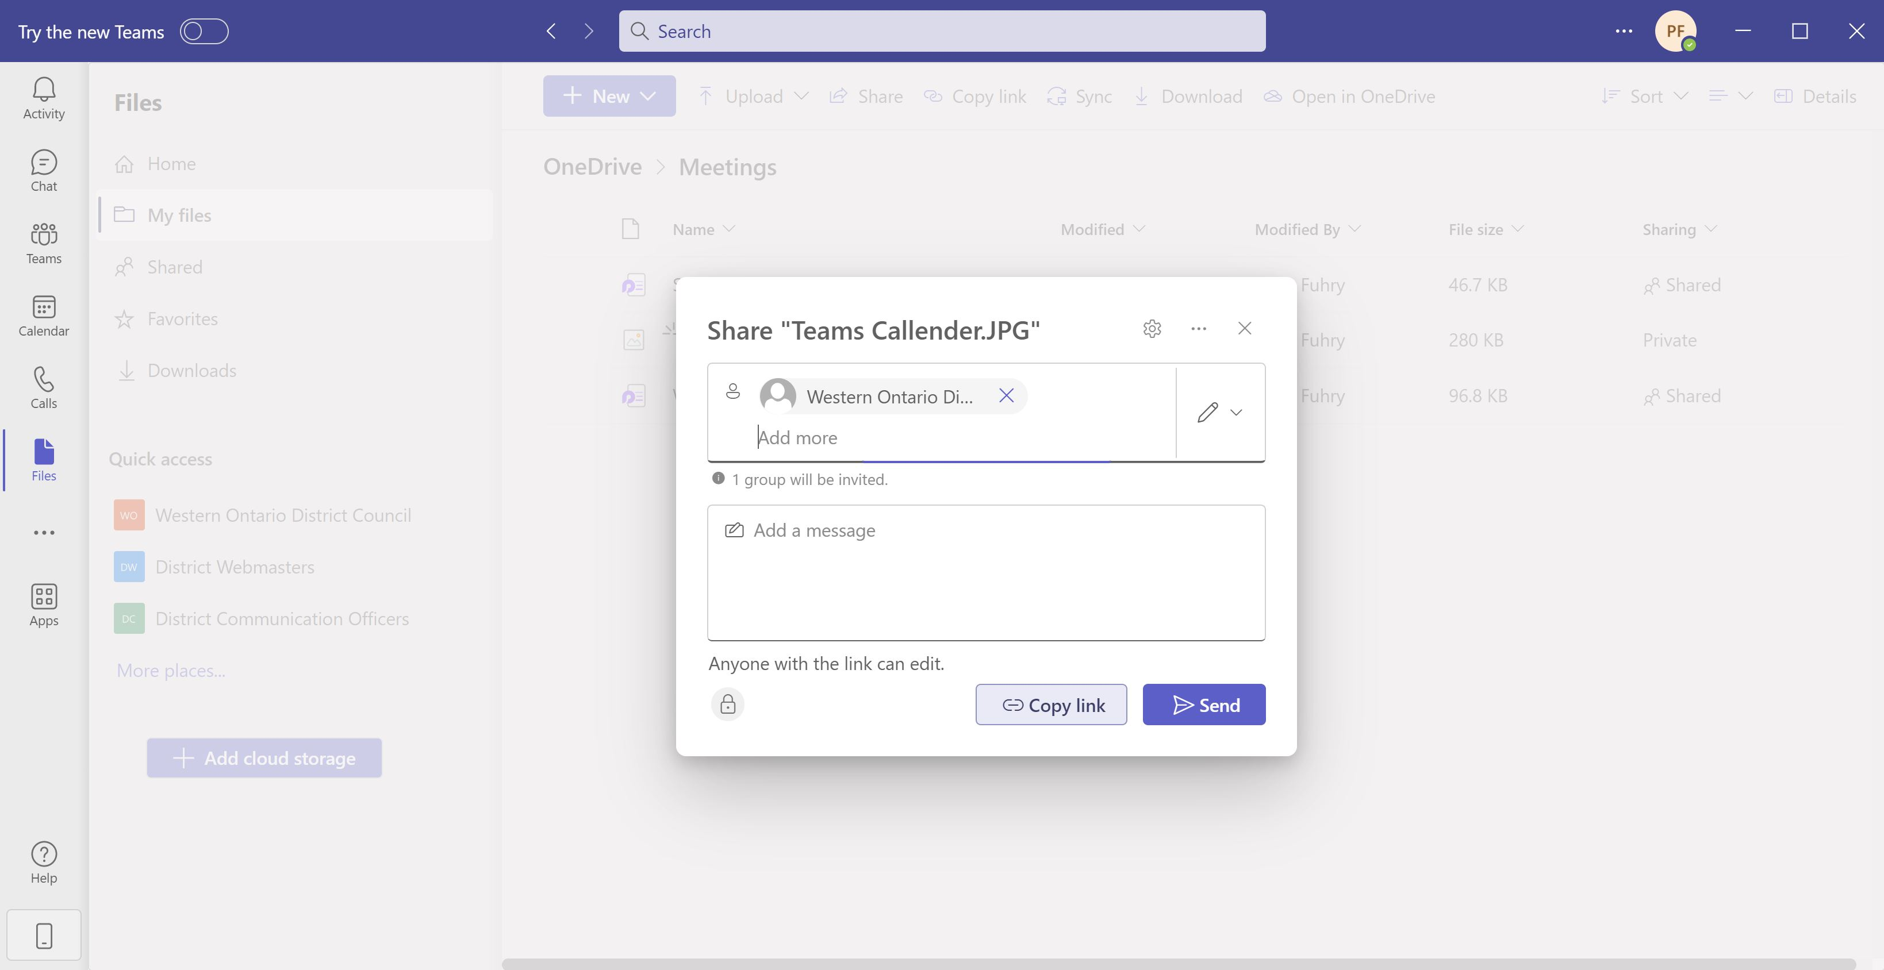
Notes:
You can add a note to the persons who are about to receive share permission and Send it

Slide 17
The End
(of this section)

