Slide 1
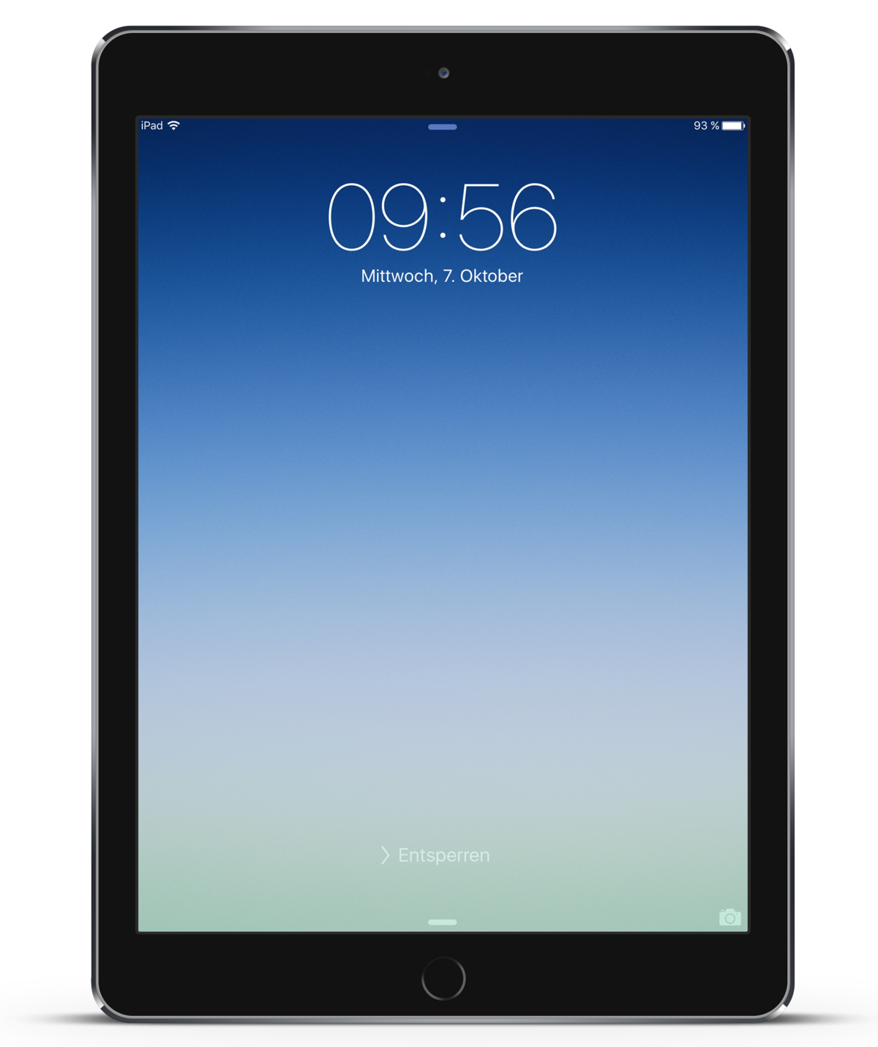
Installing and Using MS-Teams on a Mac/iOS Device
(iPad and iPhone)
Notes:
Teams is a Microsoft product and so works best on a Windows computer. It will also run on a Apple Mac or portable product. This session covers Teams on an iPad or iPhone

Slide 2
What Your Mac Computer or iPhone Needs to Run MS Teams
Mac Personal Computer/Laptop (Minimum Requirements…)
Dual Core Processor, 1.1 GHz or faster (~7 years old)
4 GB RAM
1.5 GB available disk space (can be a solid state hard drive)
1280 * 800 screen resolution
Operating System – Latest three versions of macOS (Sonoma, Ventura, Monterey ~ 7 years old or newer machine)
Turning camera on? 4 core processor recommended
Safari 14+ Browser
iPhones, iPad, iPod touch
Last two major versions of iOS (2020 needs ~iPhone 6s or newer)
Blur my Background needs iOS 12 or later (iPhone 7, iPad 2018, or iPod touch 2019 min)
Notes:
Technical requirements are quite similar to a Window system.

Slide 3
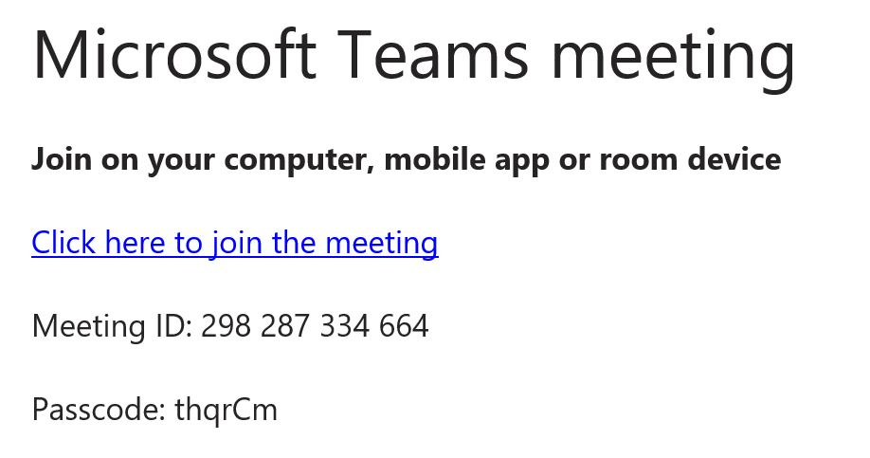
Your Invitation….
Found typically in the e-mailed Notice of Meeting
DO NOT click on “Click here to join the meeting” YET
- First, install the Teams App, then return to the Invitation
Notes:
If you are going to join a meeting for the 1st time on your iPad or iPhone…
When you get your invitation, no not click on “Click here to join the meeting” but rather install the App 1st. After installation, return to the invitation and then you can click on “Click here to join the meeting”

Slide 4
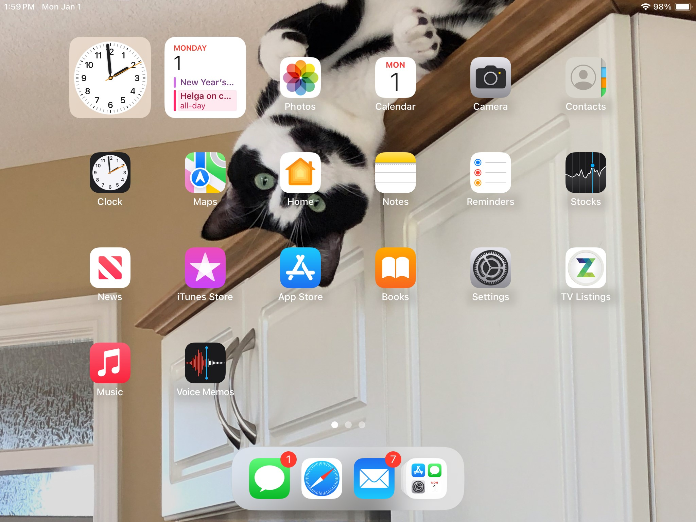
App Store
Notes:
How to Install the App
From the iPad home screen, click on the “App Store” icon

Slide 5
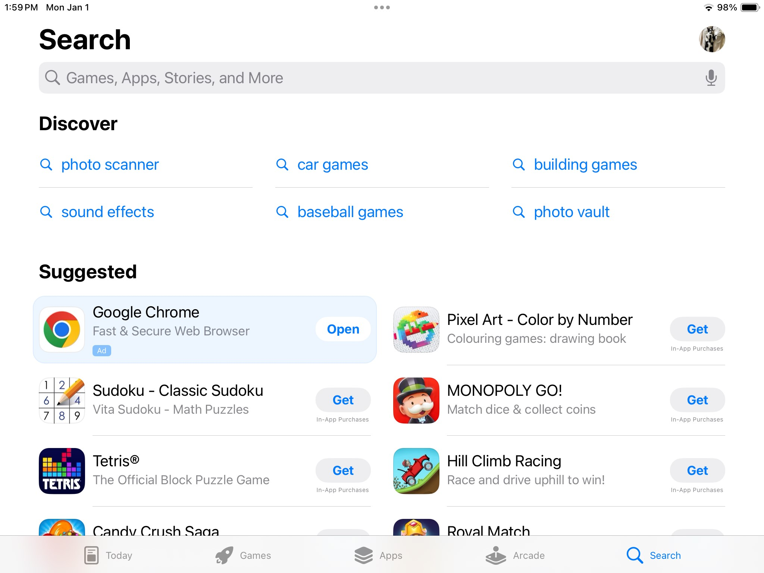
Notes:
You will get the App Store screen.
Select “Search” from the bottom right

Slide 6
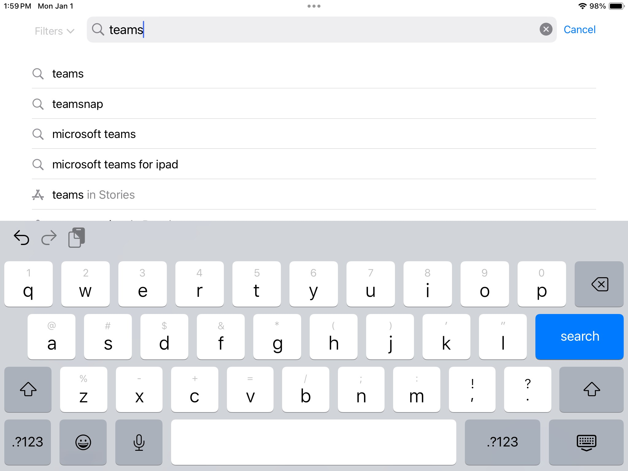
Notes:
Type “Teams” in the search box at the top of the screen and click on the blue “Search” button

Slide 7
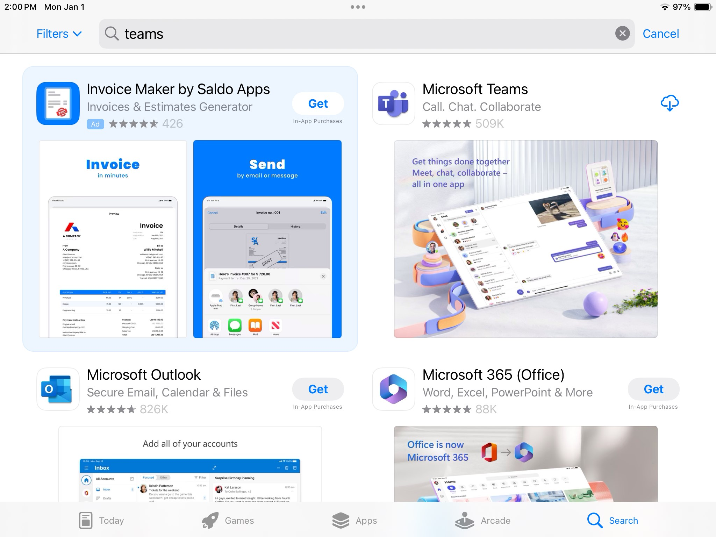
Notes:
Find the Microsoft Teams App (see the upper right app on this screen)
Click on the “Get” or raining cloud symbol
You will be asked to verify yourself (enter password, show your face to the iPhone camera….)

Slide 8
Notes:
The app will be downloaded

Slide 9
X
Notes:
Once the download is complete, Do Not click on “Open” but rather close this screen and return to the invitation

Slide 10
Your Invitation….
Found typically in the e-mailed Notice of Meeting
Click on “Click here to join the meeting”
Notes:
Click on the “Click her to join the meeting”

Slide 11
Notes:
Click on “Join as a Guest”

Slide 12
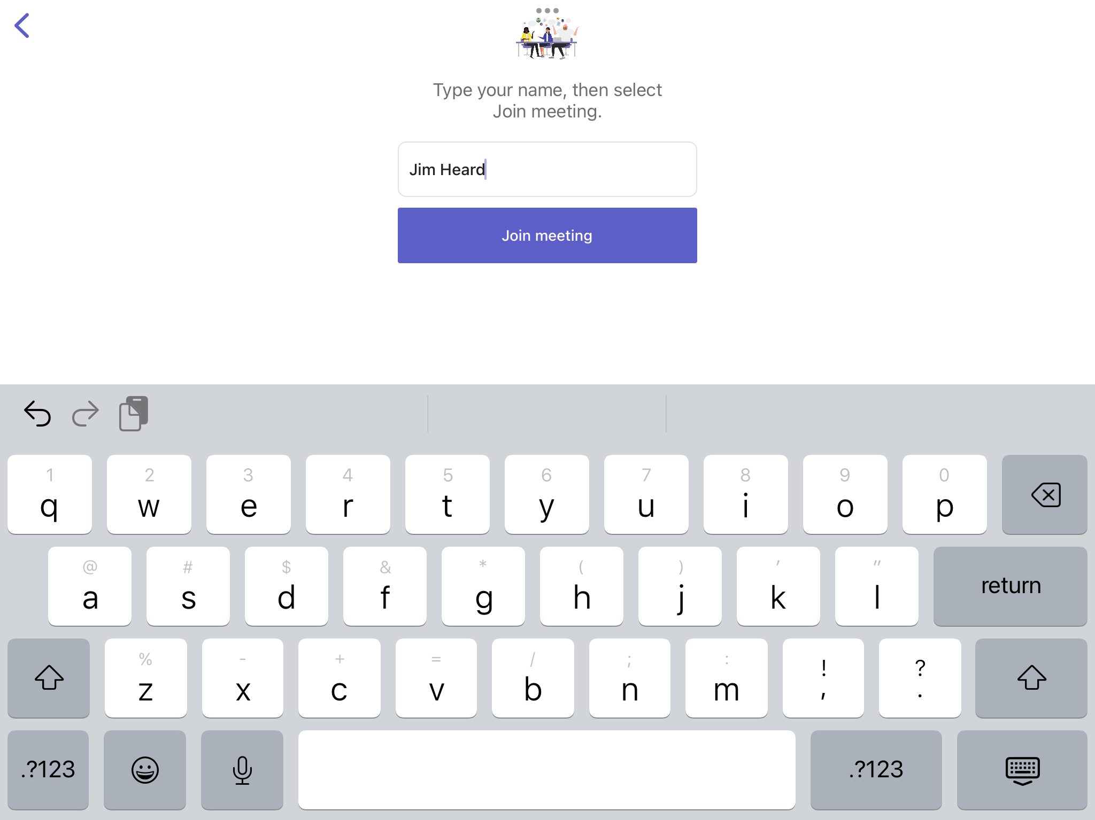
Notes:
Enter your name and click “Join Meeting”

Slide 13
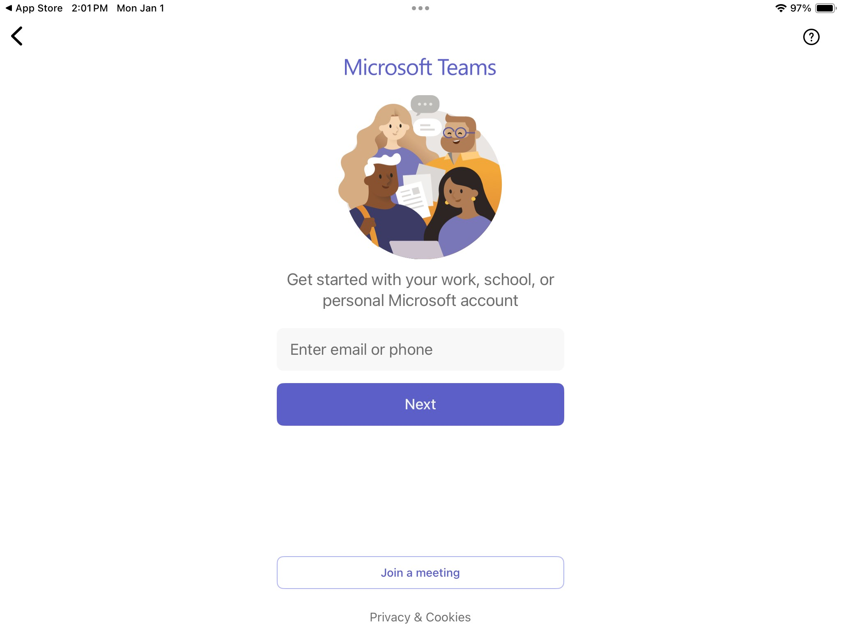
Notes:
If you see this screen (… personal Microsoft account) click on the “Join a Meeting” button

Slide 14
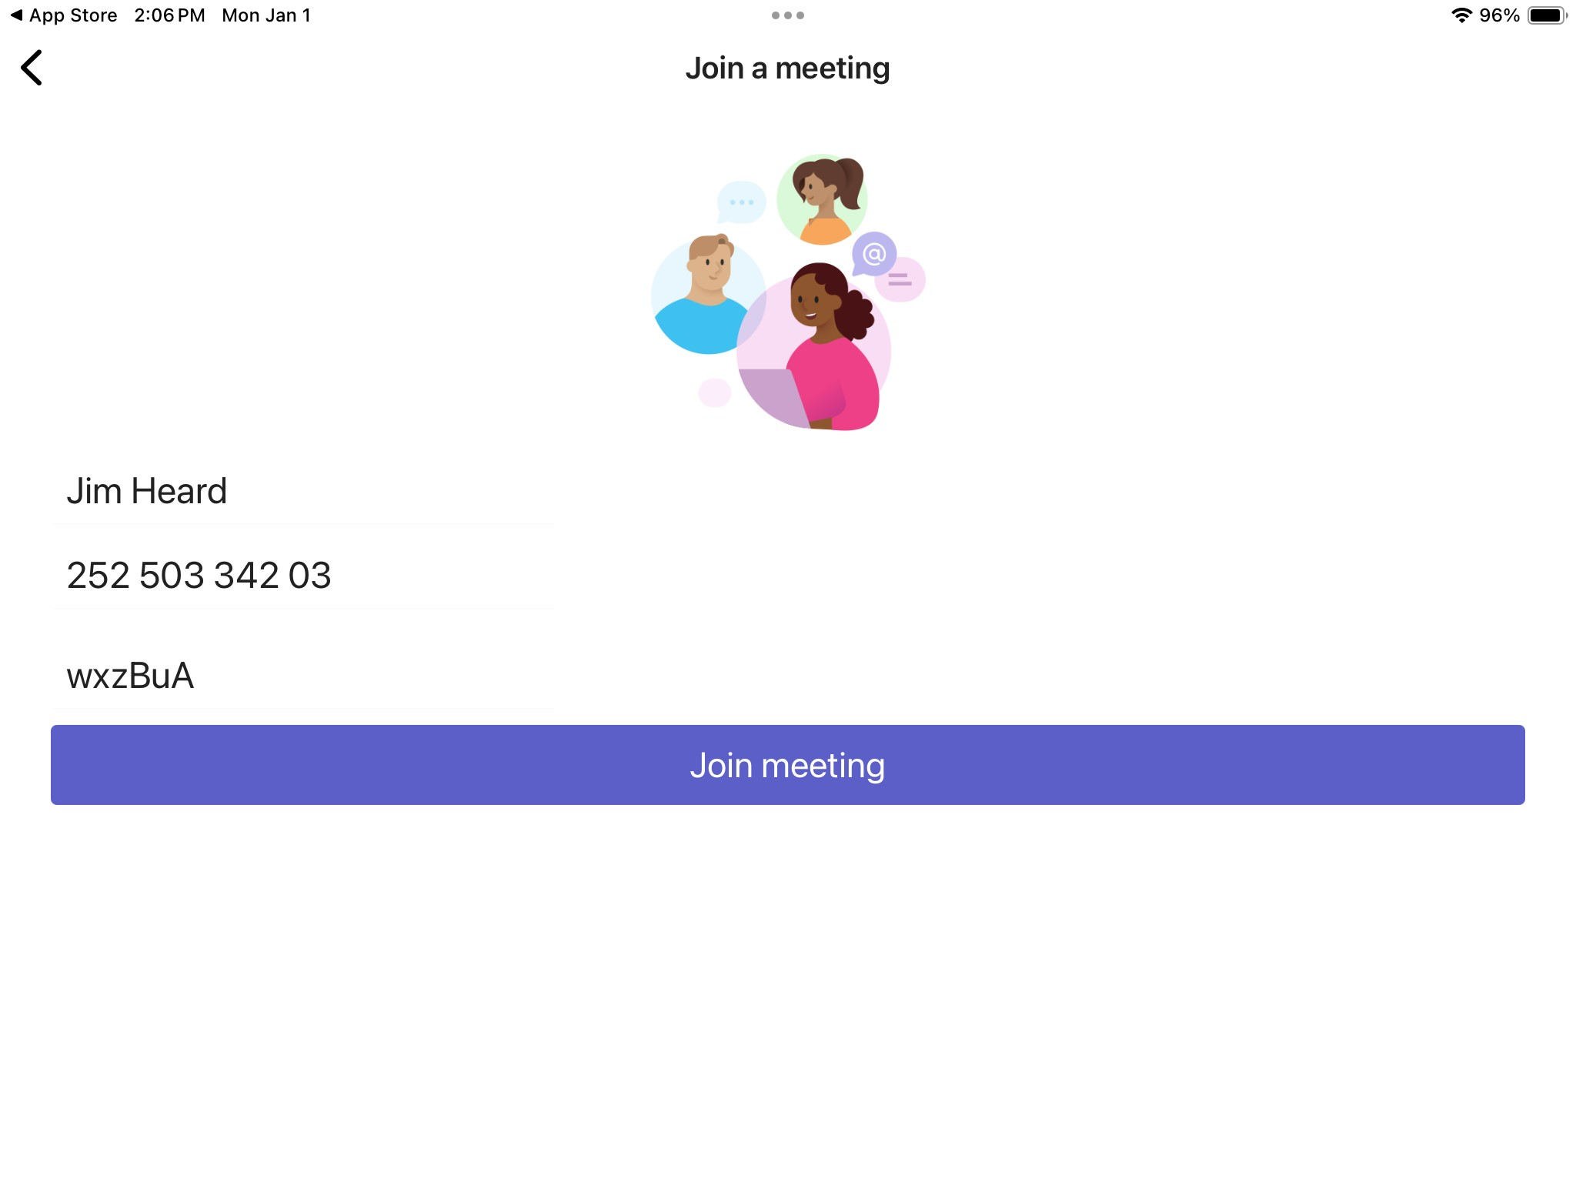
Enter Name, Meeting ID, and Passcode
click “Join Meeting”
Notes:
Enter your name, Meeting ID and passcode and click on “Join Meeting”
Where do you get the Meeting ID and passcode? From the invitation

Slide 15
Your Invitation….

Slide 16
Notes:
Either way you see this screen as Teams attempts to join the meeting

Slide 17
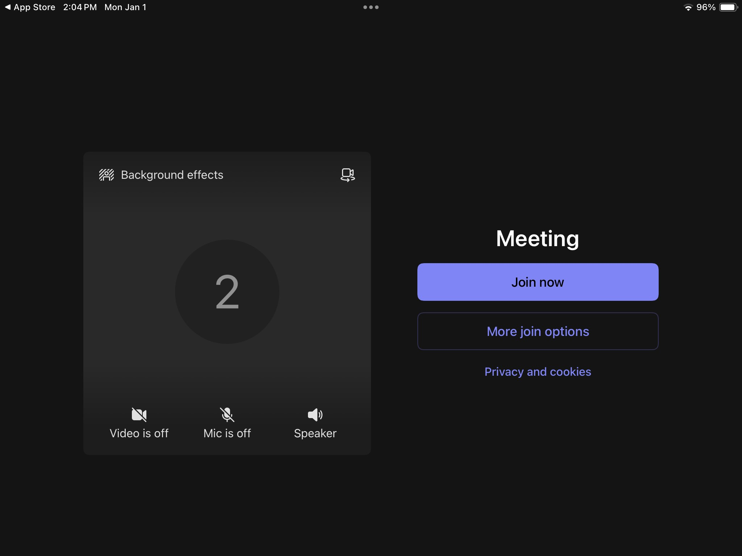
Notes:
You will be asked if the App can use your microphone and camera (say Yes) and you will get to this screen. Click “Join Now”

Slide 18
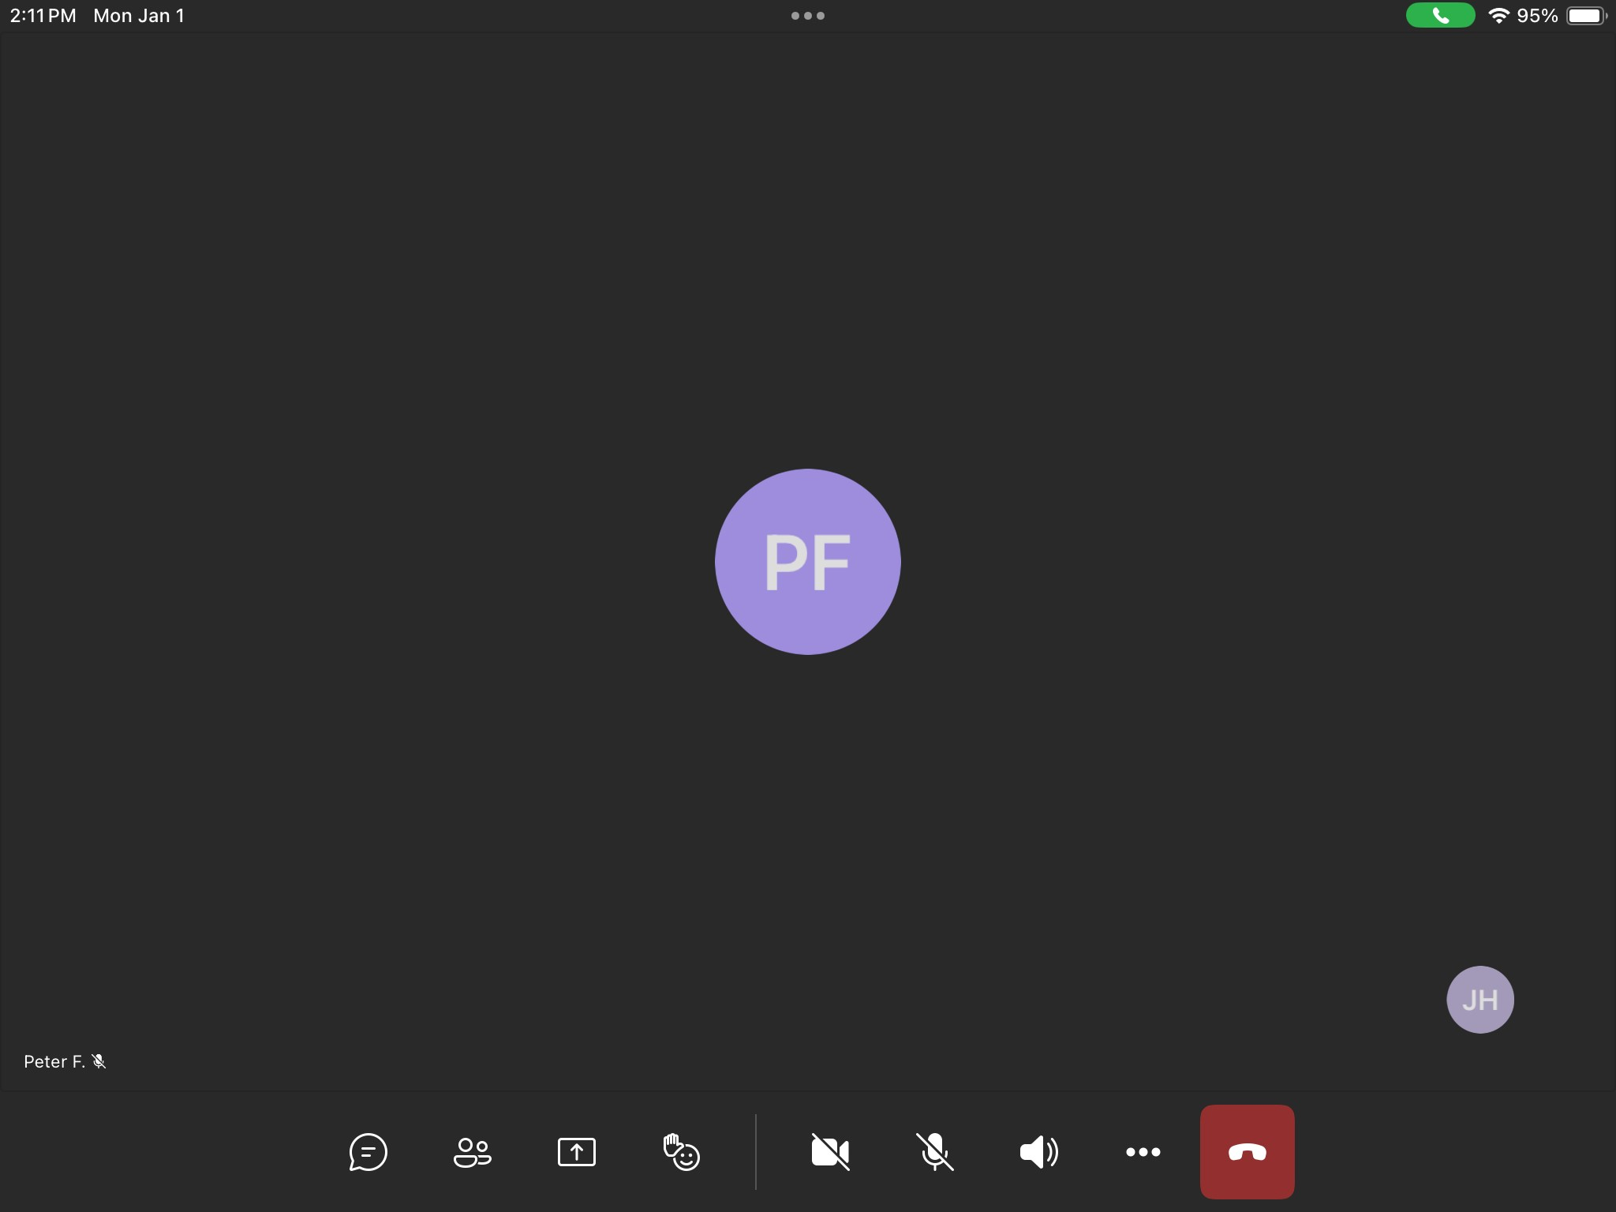
Notes:
You are in the meeting. Your icon or camera image is in the lower right hand corner

Slide 19
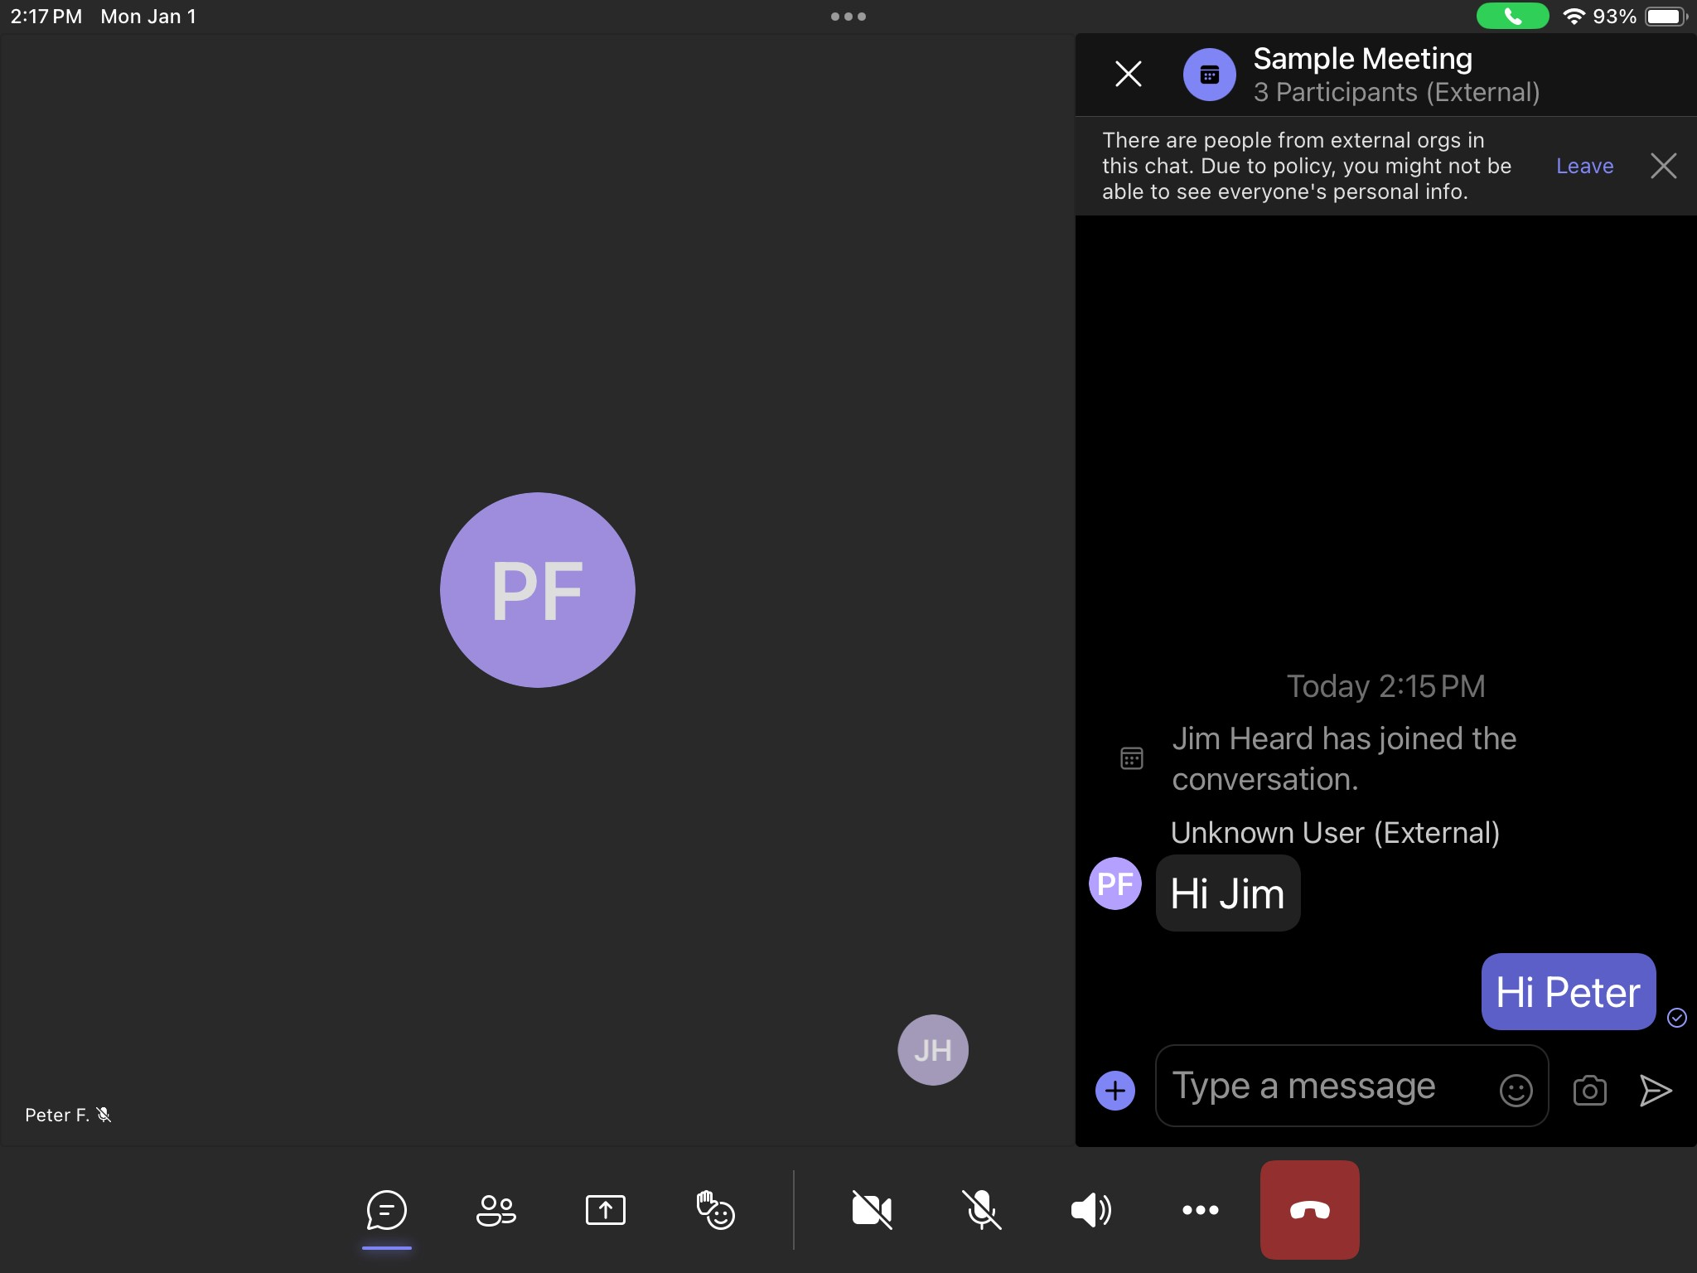
Notes:
Along the bottom of the screen is a series of buttons. The one furthest to the left is “Chat” Clicking on it brings up a chat column appears on the right side of the screen. You can type the message and click on the right most button to send it (looks like a paper airplane pointing right)

Slide 20
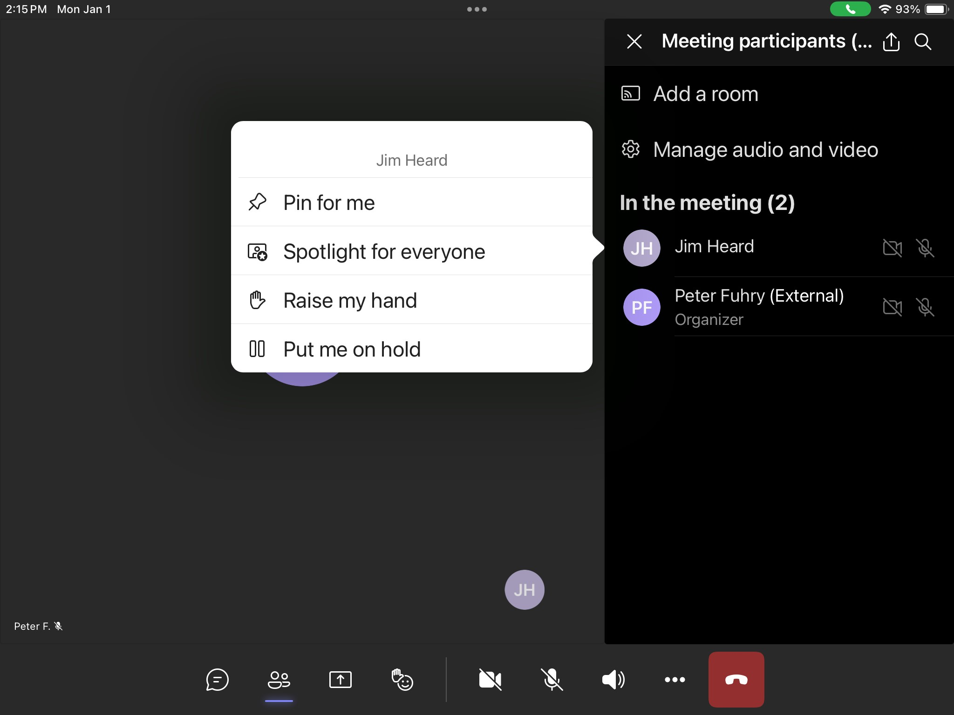
Notes:
The next button is “People” which provides one with a list of meeting participants. Clicking on your name gives you a chance to raise your hand

Slide 21
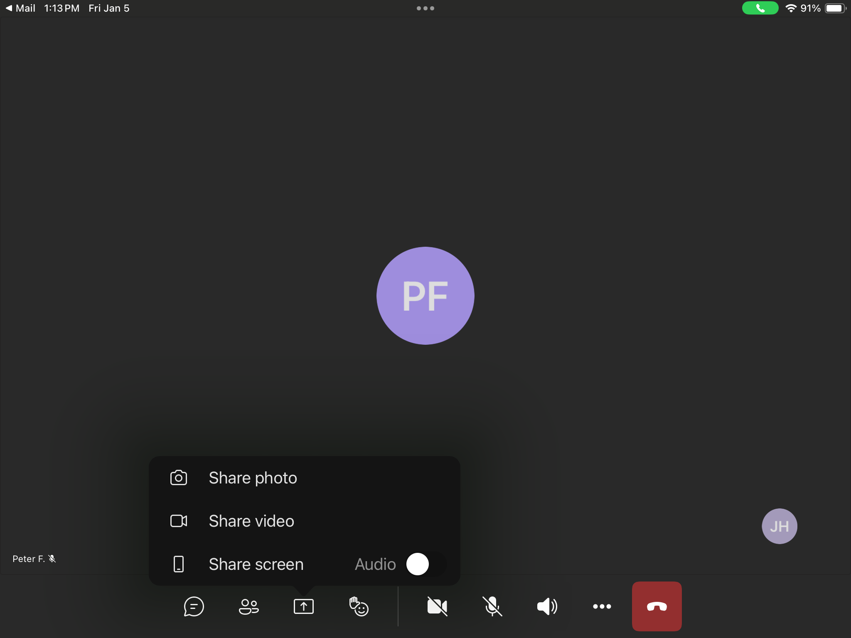
Notes:
The button beside “People” is “React” which permits you to add a temporary icon to your image on others screens. A raise-your-hand is also an option in this selection

Slide 22
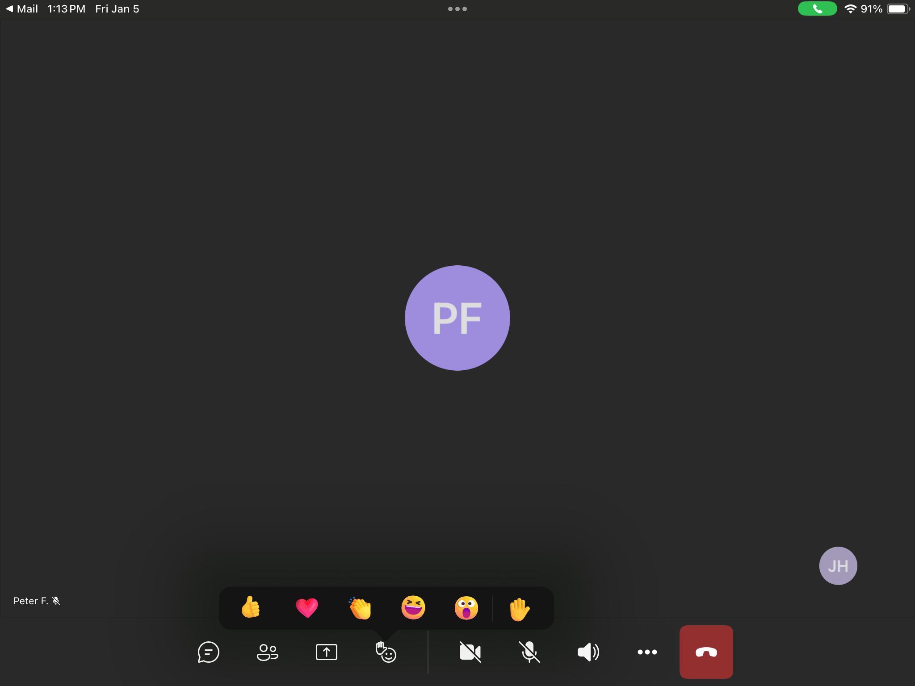

Slide 23
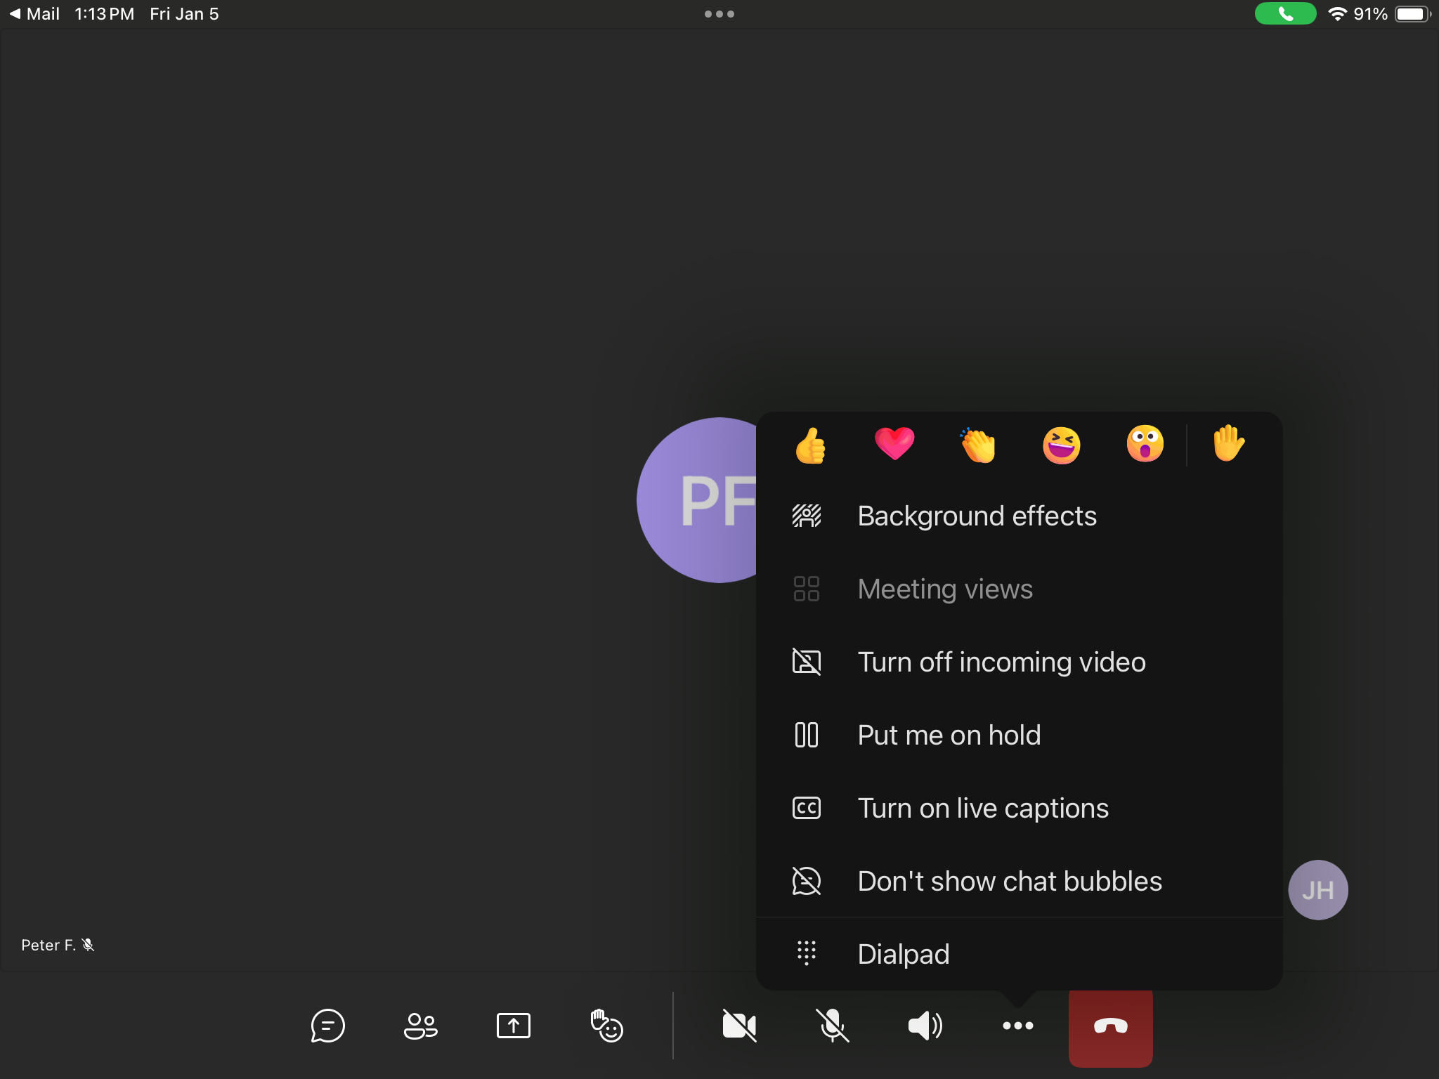
Notes:
The ellipses (ie … ) brings up a menu with “Turn off incoming video” as well as the reaction icons and the raise-your-hand

Slide 24
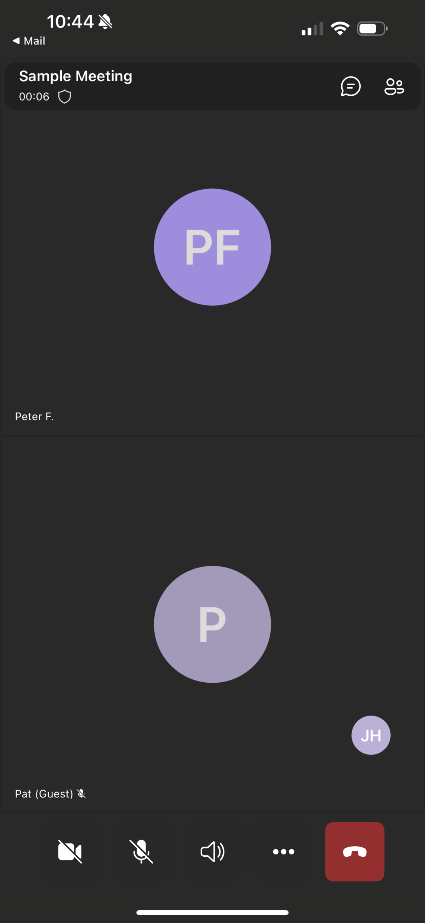
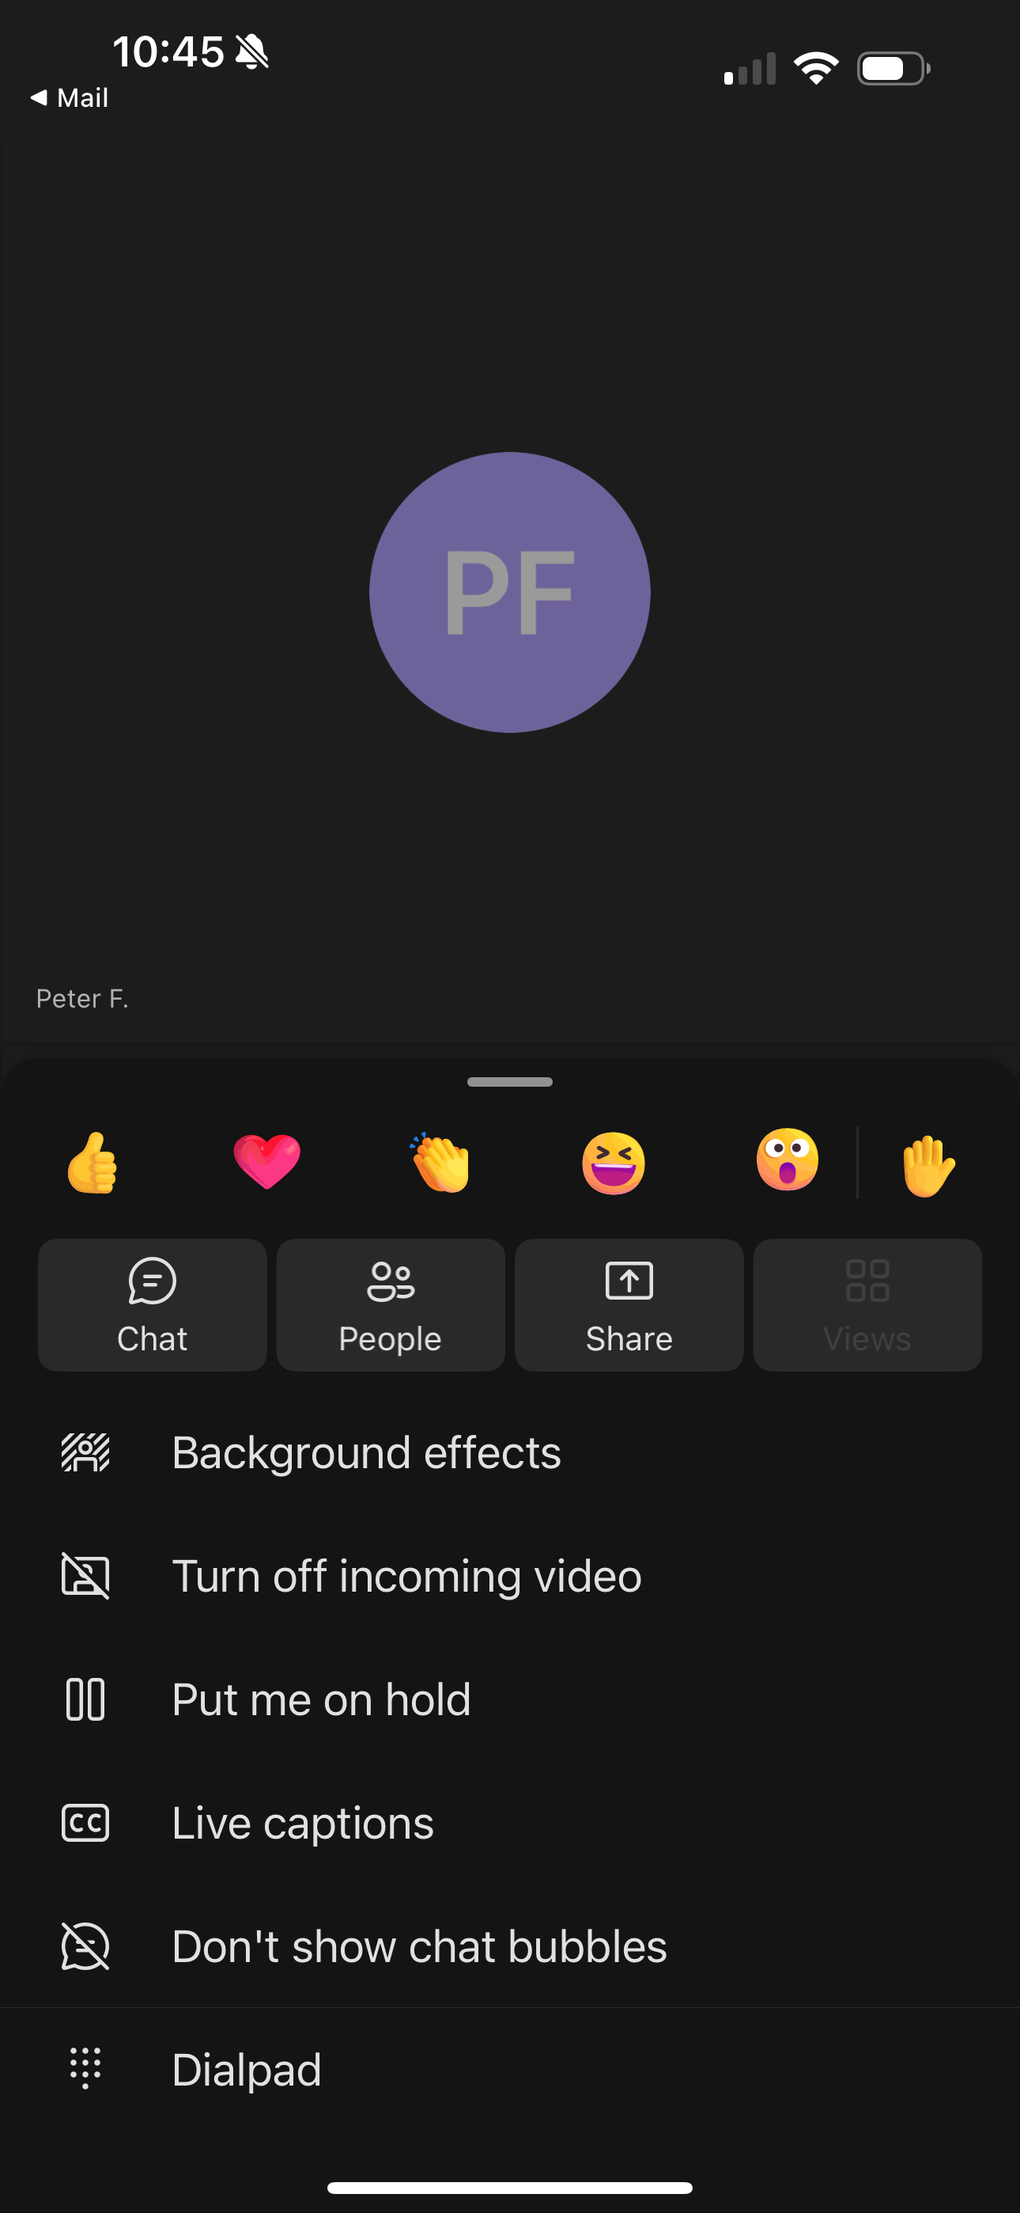
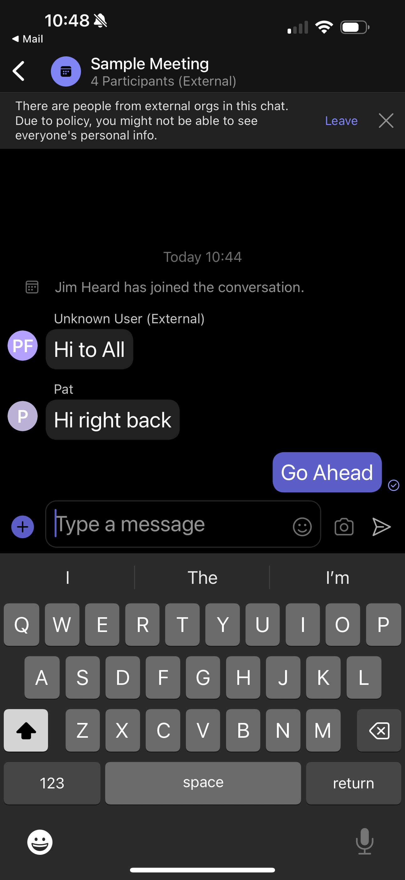
Notes:
For and iPhone the screen is smaller. The Chat and People button is at the top of the screen (left screen image).
If you click on the ellipse, you get the centre screen image. All the functions can be found on this screen by clicking on the ellipses (ie … )
The right screen image shows the chat function on the iPhone

Slide 25
Questions?

